Slide 1
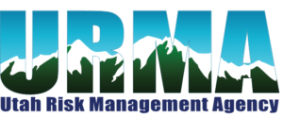
URMA Summer Conference
Heritage Theater
July 29-30, 2026

Slide 2
LESSONS LEARNED FROM BAD CLAIMS – A CLAIMS review From A Risk management perspective
Goals of this session:
Review adverse claims against public entities.
Show potential exposures to Utah cities. Maybe reaffirm the things we are doing right. Maybe open your eyes to new exposures.
Review Risk Management solutions and alternatives.

Slide 3
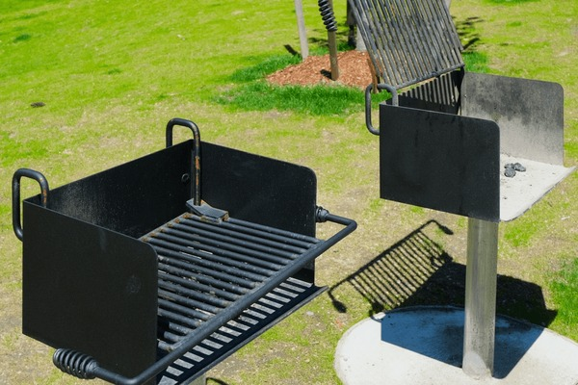
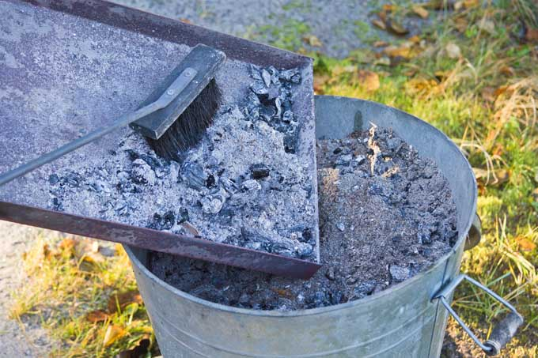
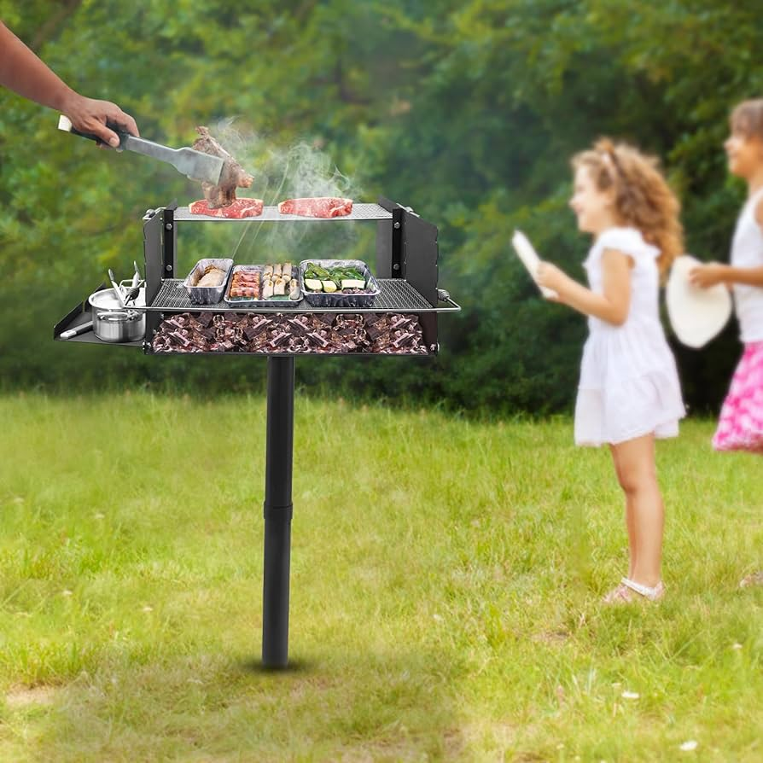
Parks and Recreation Exposures
- barbecues
Facts of Claim: Public entity received a number of claims over the years of children getting burned when playing around the barbecues. So the public entity set protocol to clean out barbecues periodically to remove the hot coals and clean the grills. A claim was filed after a park’s employee was responsible for emptying out the barbecues throughout the park. As he was carrying the hot coals for disposal, he witnessed another emergency (injured child). He set the hot coals down away from the public, next to some shrubs and attended to the injured child. Some children were playing tag and one of the children jumped over the shrub and landed (one leg) into the hot coals. Received severe burns on his lower leg.
Claims Expense - $250,000+
Risk Management Course of Action – Removed barbecues that were close to children play areas, tightened up protocol for collecting hot coals. Some public entities just picked up hot coals at the end of the day.

Slide 4
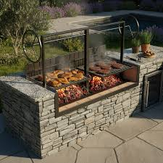

Facts of Claim: Public entity had in place protocols to lock up the Argentinian style barbecues at the end of each day. One Friday, the parks department failed to lock up the barbecue (prevent it from being able to crank up and down). Over the weekend, some young kids were playing at the park and found the unlocked barbecue. Somehow they figured out that they could crank the barbecue all the way up with one kid on the grill and let the crank go and the grill would quickly drop (a very short thrill ride). A young girl with pig tails took her turn on the barbecue. When the kids released the crank, the young child’s pig tails wrapped around the crank while it was dropping causing very painful scalping type injury to the child.
Claims Expense - $275,000+
Risk Management Course of Action – this particular entity removed the Argentinian style barbecue from its park and replaced it with another large style barbecue. Other public entities reviewed their protocol on locking up the barbecues at the end of each day.
PARKS AND RECREATION EXPOSURES – CRANK STYLE BARBECUES

Slide 5
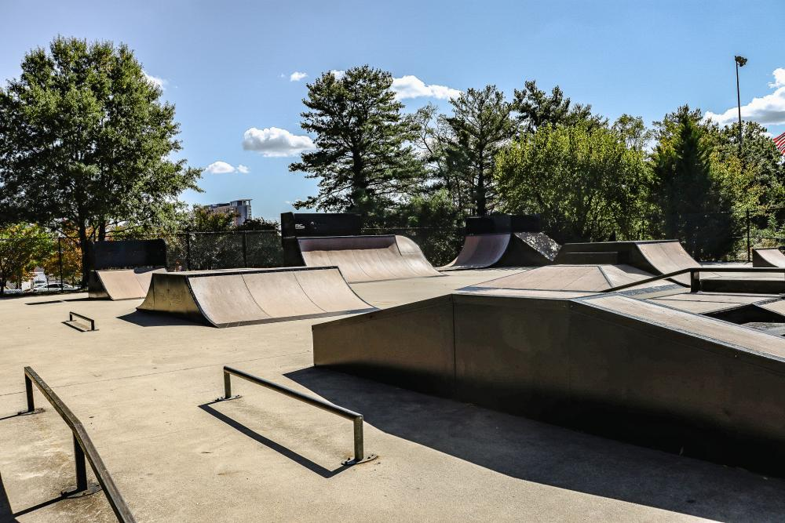
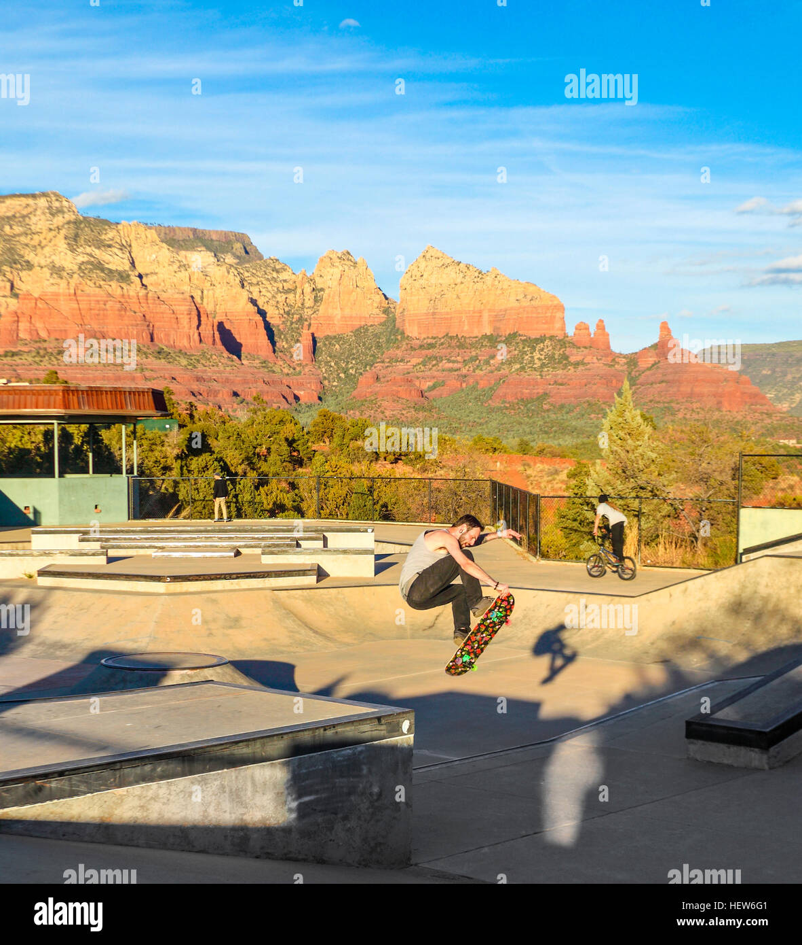
Parks and recreation exposures – SKATEBOARD pARKS
Facts of the Claim: A young boy was injured at a “skateboard park” when he ran into a biker also riding at the skateboard park when both were doing jumps. The skateboard park was supervised by a public entity employee. The skateboard park was NOT a multi-use park. The kid was young and small. The biker was a teenager and rather large kid. The skateboarder broke his femur and had multiple surgeries and it appeared as though he would need additional medical care in the future.
Claims Expense: $250,000+
Risk Management Course of Action: Provide better training to employee. No mixed use at the skateboard park (skateboards only). The public entity decided to continue supervision at park, but many of the other public entities either changed to no supervision or continued their policy of no supervision at the park.
Utah Code 78B-4-509 Inherent Risk of Certain Recreational Activities (skateboarding, roller skating, bike riding, scooter riding…on property) provides public entities with protection. California had similar protections for public entities. The attorney's representing the public entity recommended settlement because we had someone supervising the skatepark and allowed a biker to use the facility. We had signs that stated that it was a skatepark and not a multi-use facility (no bikes, roller skating, scooters allowed). Also, there was concern with the age and size difference with the users that magnified the injury.

Slide 6
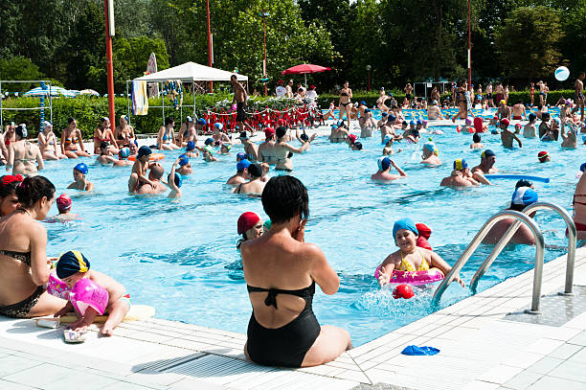
PARKS AND RECREATION EXPOSURES – SWIMMING POOLS
IT’S NOT “IF BUT WHEN” FOR SWIMMING POOL CLAIMS.
FACTS OF THE CLAIMS:
  Supervisor arrived at the Pool and observed that the water was slightly cloudy. Pool staff checked the chemicals and filtration and couldn’t find any problems. They decided to open the pool. What they didn’t realize that when the sun came up overhead, that the cloudiness mixed with the sun’s rays made the glare on the pool dangerous. It was a crowded day which made it even more dangerous. Likely as a result of the glare, a child drowned. Lifeguards didn’t see the child in time to save them.
CLAIMS EXPENSES: $1.6 million
RISK MANAGEMENT COURSE OF ACTION: A pool should never open if the water is cloudy. You put a lot of pressure on lifeguards if you open. You are limiting their ability to see individuals that may be on the brink of drowning. Also, this claim did not result in a WC claim, but the employees did require some counseling.

Slide 7

PARKS AND RECREATION EXPOSURES – SWIMMING POOLS
FACTS OF THE CLAIMS: A former Navy Seal swam at the public entity pool 3-5 times a week. He would swim underwater regularly (across the pool and back). The individual lost consciousness (hypoxic blackout) while swimming and died. He had been swimming for many months for exercise. Attorney’s for the spouse alleged that the lifeguards were negligent because: 1) they were NOT watching the Navy Seal; 2) they knew that he was a good experienced swimmer, so they didn’t watch him.
CLAIMS EXPENSES: Potential exposure. We paid legal expenses of over $50,000.
RISK MANAGEMENT COURSE OF ACTION: Make sure your lifeguards are trained in Underwater Hypoxic Blackouts (UHB). Many times with UHB the arms and legs move involuntary in a swimming like motion when they lose consciousness making it difficult to recognize drowning. Many pools now prohibit prolonged underwater breath holding (for more than a few seconds). Signs should include underwater breath holding and hyperventilation are prohibited. Some pools have installed “Computer-based drowning detection systems (within 10 seconds it lets lifeguards know of bodies coming to rest at bottom of the pool).

Slide 8
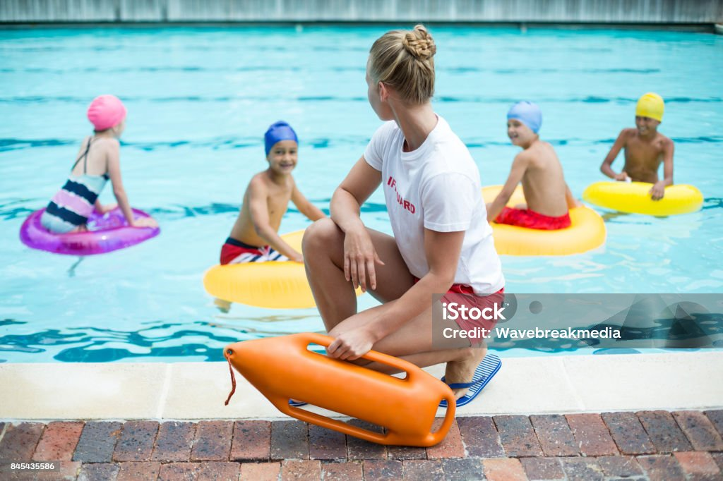
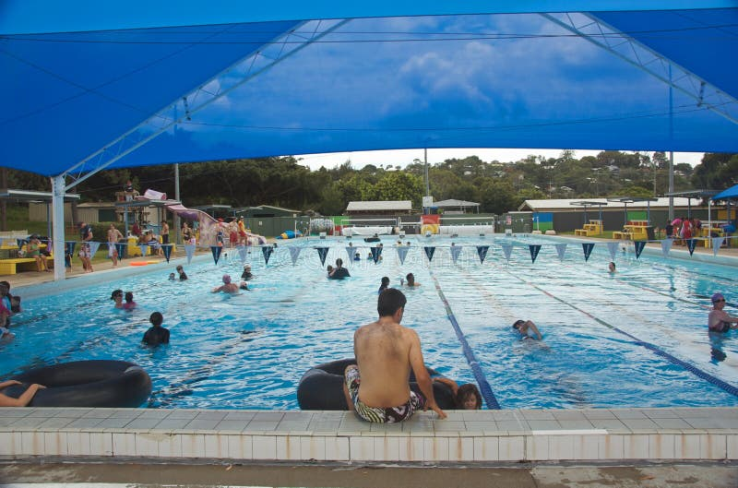
Swimming pool safety
Train, Train and Train. You can never train enough with your lifeguards.
Many times your lifeguards are teenagers (16 – 19). Many times when a claim occurs your lifeguards do not make great witnesses AND sometimes as a result of a drowning or near drowning your lifeguard may need counseling/therapy as a result of the incident and may even file a WC claim. So you obviously want to prevent drownings or injuries at your pool – PREVENT a claim from occurring!!!
Make sure that they are rotating spots regularly to prevent inattentiveness. A number of my members rotated every 30 minutes.
Train in UHB.
If you are not already doing it – look at a policy to prohibit prolonged breath-holding under water to prevent UHB. American Red Cross recommends that lifeguards stop any breath holding longer than 20 seconds.
Make sure pool personnel are adequately trained in pool chemical safety and that the proper safety equipment is provided and well maintained (respiratory protection, eye protection, MSDS sheets, etc.)
Many public entity pools have the 10/10 or 10/20 rule. 10 seconds to scan their designated area and 10 seconds or 20 seconds to reach their person in distress. According to Red Cross, you have between 90 seconds to 3 minutes to pull a drowning person from the water before the situation becomes life threatening or fatal. That doesn’t leave much time for any mistakes!!!!

Slide 9
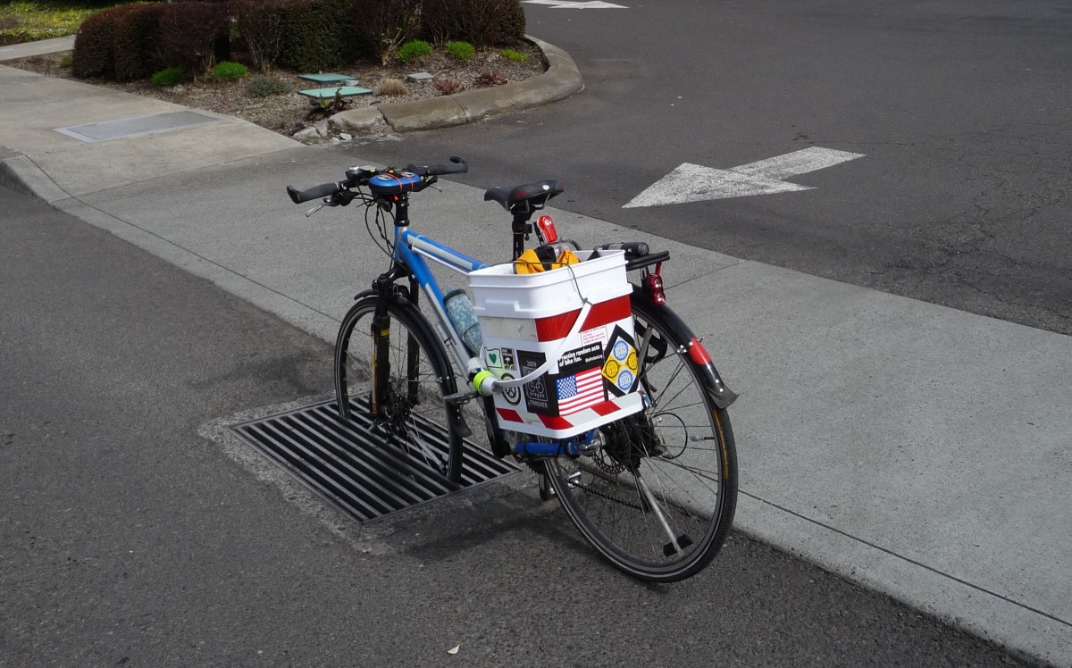
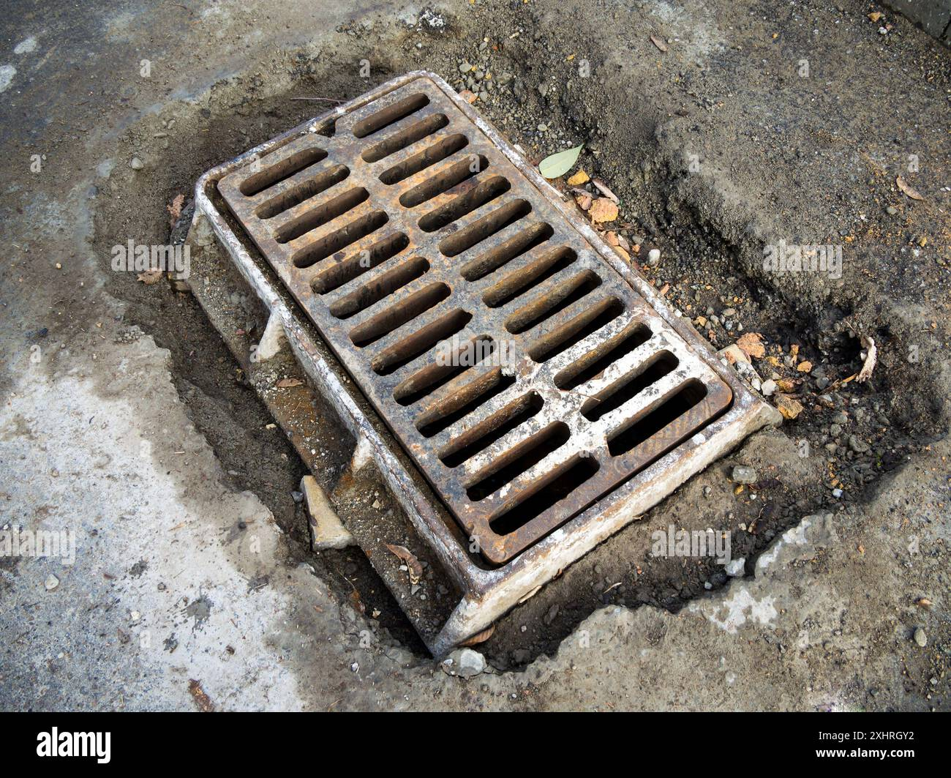
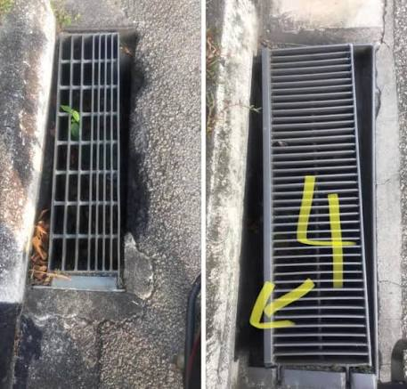
Public Works exposures
Facts of the Claim: An attorney that was a partner in a very large firm located in a large city rode his bike just about every day around the city for exercise usually at lunch or right after work. He would change his route periodically to, as he put it, to increase the fun on the bike ride. He was riding at lunch on a new route and he hit a raised storm grate which caused him to fall off his bike breaking his neck along with other injuries causing paralysis (quadriplegia). The grate was lifted by more than an inch and there was debris (dirt, leaves, etc. that caused the grate to stay lifted). The maintenance records on the grates from the City were sketchy at best.
Claims Expense: The claimant was asking for $20 million (he wasn’t able to return to work at his law firm). City/Pool countered at $5 million. Eventually settled for $10+ million).
Risk Management Course of Action: The City along with other members of the pool improved their maintenance and inspection program for their sewer grates that included better recordkeeping.

Slide 10
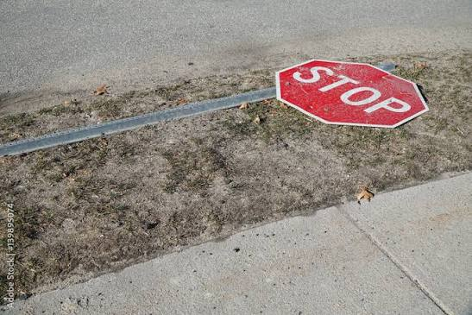
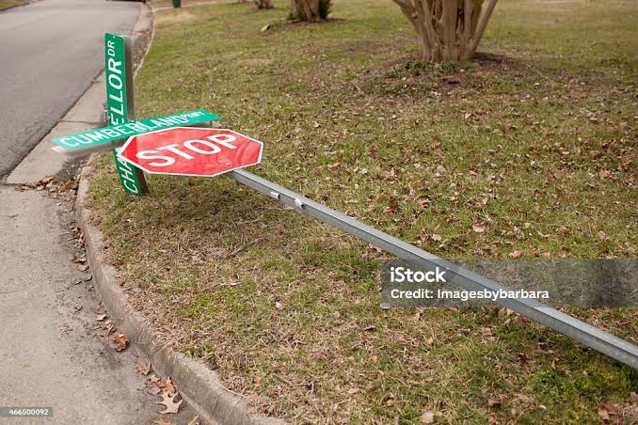
PUBLIC WORKS EXPOSURES - STREETS
Facts of Claim: The Administrative Assistant at Public Works received a call on a Thursday or Friday very close to her quitting time regarding a downed stop sign on a cross street to a highway. The Admin. Assistant took the information down and proceeded to get ready so that she could leave to go home. In her haste to go home, she did not pass on the information for the downed sign. Over the weekend, a car full of teenagers was driving on the cross street where the stop sign was down and drove through the intersection and was struck by a semi-truck. All the passengers in the car died in the accident.
Claims Expense: $3+ million was the settlement.
Risk Management Course of Action: PW conducted a number of training courses dealing with the proper protocol for all PW personnel regarding downed signs, traffic signals being out and recordkeeping dealing with this liability exposure.

Slide 11
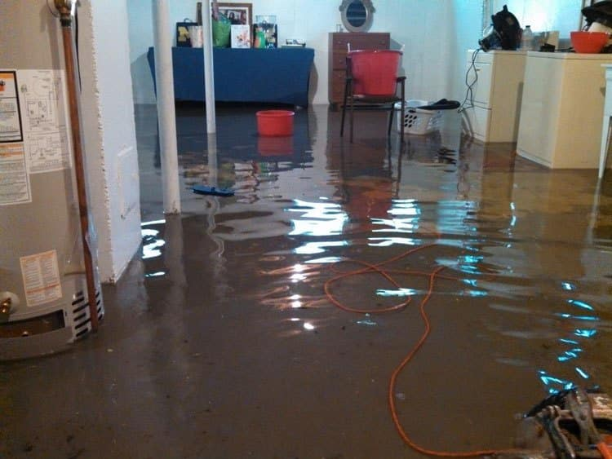
PUBLIC WORKS EXPOSURES - sewer
Facts of Claim: A $4 million home had a sewer backup into the basement of their home. About 1 ½ feet of sewage backed up into their basement. This home was in a new subdivision of million dollar homes. Maintenance records were sketchy because it was a new subdivision and the lines were not TV’d. It looks like the line was crushed or damaged likely by one of the builders.
Claims Expense: Settlement was for $350,000++. Difficult settlement because the homeowners did NOT want to move back into their home.
Risk Management Course of Action: Good and consistent maintenance records are a must. Anytime in new construction areas you should be TVing the lines and document it. This should be done by the public entity. Many contractors like to do it also so they can identify debris, cracked lines and blockages (quality assurance).
Sewer claims are one of the hardest claims to settle. Many people do not want to go back into their homes. Many claimants do NOT have sewer backup coverage. Public entities/wastewater agencies are liable only if the incident results from their own negligence or failure to maintain the public main line. They are immune from liability for private lateral lines (house to the main), weather conditions/high volumes of water/debris or if blockage was the result of another party. The majority of sewer backups are denied because of various causes: political signs dumped into the sewer, spoiled salmon dumped into the sewer and damage to the lines as a result of the chemicals used by a brewery. Sewer districts/public entities MAY even deny claims due to the neighbors dumping/flushing items down into the sewers.

Slide 12
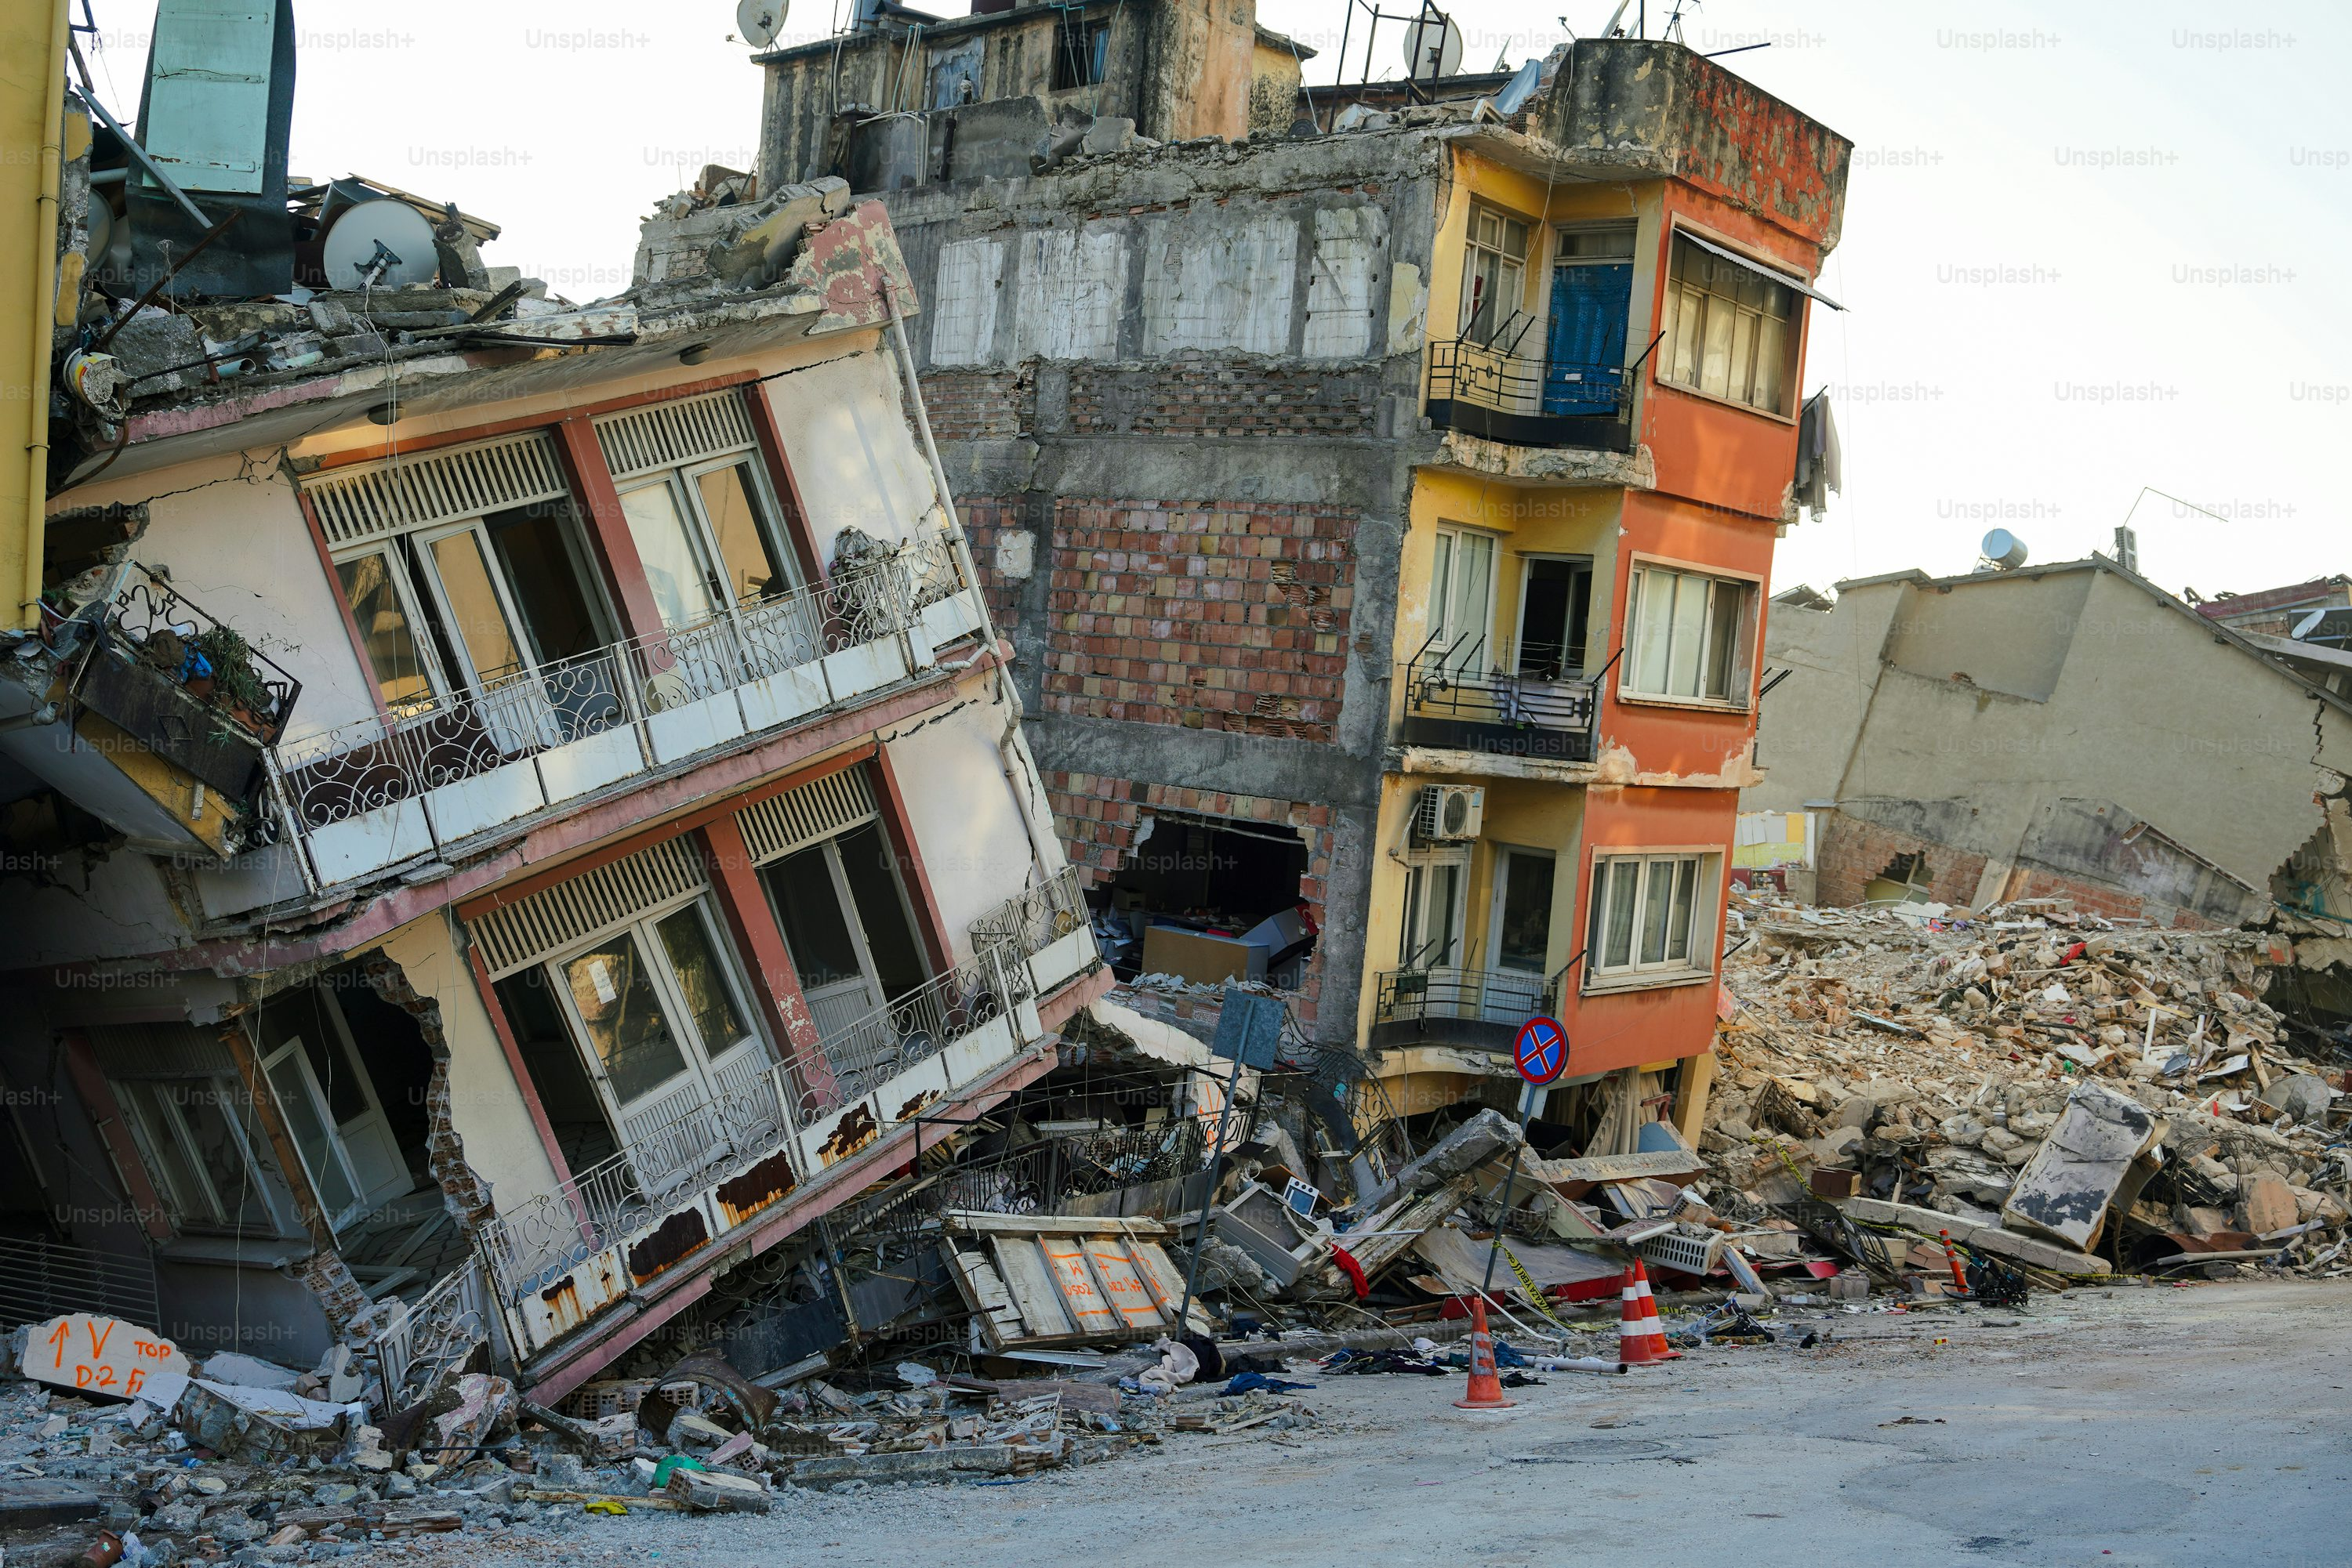
Property claim exposures
Facts of Claim: On February 26, 2026, Seattle survived a 6.8 magnitude earthquake. One of the members of the insurance pool (water and sewer districts) had significant damage to their water tanks. One of their tanks was valued at $350,000 on the schedule. As a result of the earthquake, the water tank turned about 180 degrees resulting in $680,000 in damages. Valued at $350,000 versus damage of $680,000. We have a problem????????
Claims Expense – The Property carrier paid the $680,000+ in damage, but with some requirements from the Member AND the other member entities in the insurance pool.
Risk Management Course of Action – The member entity with the water tank damage was required by the property carrier to have ALL of their structures assessed by a property appraisal firm. All of the members of the insurance pool had to have all of their structures valued over $250,000 assessed by a property valuation firm. We were lucky that they didn’t deny coverage for being under valued. Premiums increased significantly the next renewal because of the under valued assets. The under valued water tank went through the annual Marshall Swift assessment along with constant reminders for checking your values for their structures.
Make sure you are checking your assets to ensure that your values are accurate and to ensure that you have sufficient coverage in the event of a disaster. Especially those specialized structures (water tanks, sewer pump stations, water slides, wave pools, playground equipment, etc.) Also, having accurate values provides equity to insurance pool members that everyone is paying their fair share of premiums.

Slide 13

Workers’ compensation exposures
Facts of Claim: Parks employee was walking through the park when he witnessed a woman being assaulted by 5-6 gang members. The employee rushed in to break up the assault and to protect the woman. The group of gang members severely beat the park’s employee to the point where he was a paraplegic. The woman was also badly injured.
Claims Expense – Total incurred for the Workers’ Compensation claim was $13,000,000+. The WC insurer had paid $6,000,000 with $7,000,000 in reserve.
Risk Management Course of Action – All of the public entity members of this insurance pool provided “BETTER” training in regards to how to handle these type of emergency situations (Calling 911; waiting for backup, etc.)

Slide 14
(3) Million Dollar Employee

Slide 15
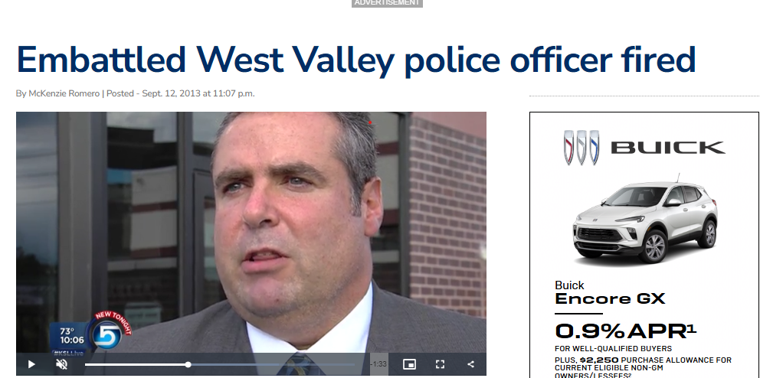
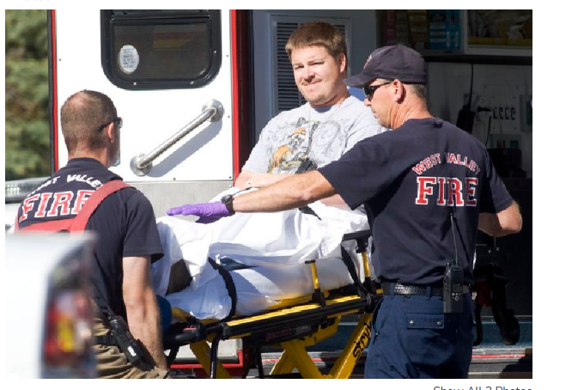
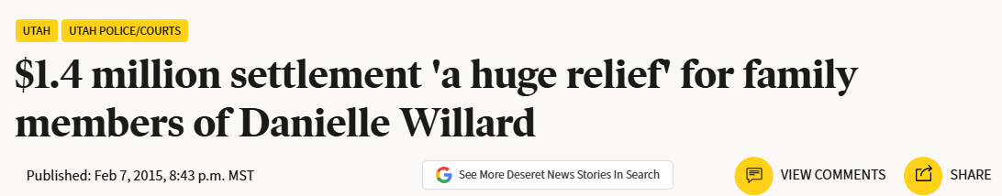
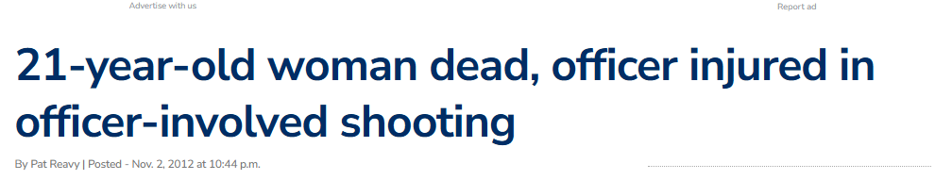
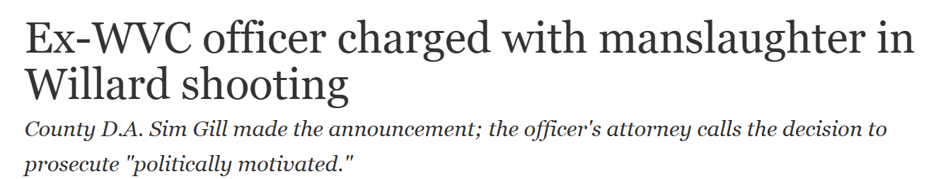
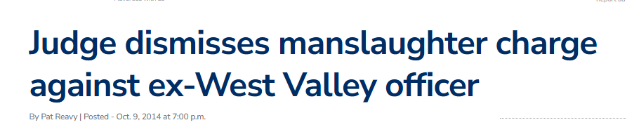
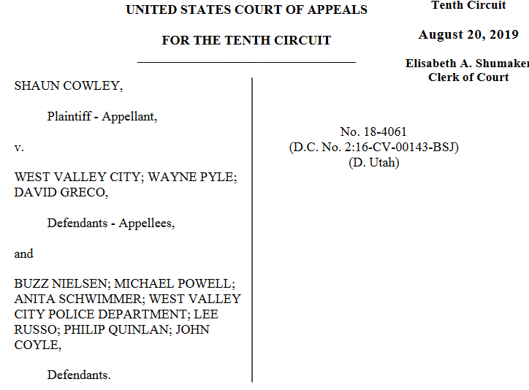
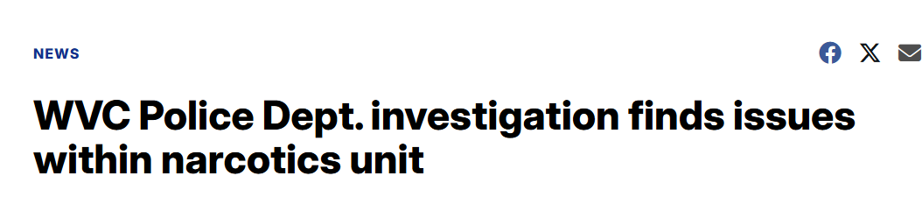
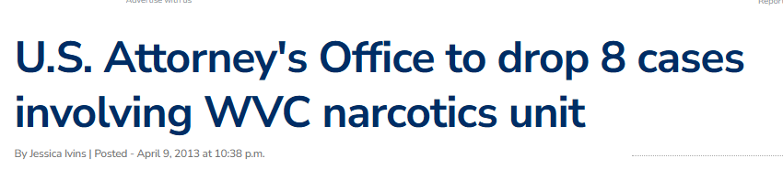
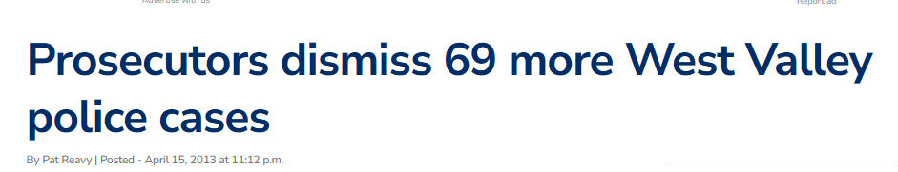

Slide 16
Danielle Willard Shooting
11.2.2012
NNU Disbanded
11.2012
Swasey/Ketchens $592,039.99
Christiansen – trial $837,528.31
Cowley
Willard Family Sues City and Cowley $1,887,427.25
DA Files Homicide Charges Against Cowley
2014 (Dismissed)
Cowley Terminated by WVC
9.2013
Cowley sues City for Civil Rights violation 2016-2020 Dismissed - 7,931.54
Fees 2014-2024 $322,600.92
Coyle- Admin Appeal 79,295.18

Slide 17
Total Cost
$3,726,823.19
(5.1M 2026)

Slide 18
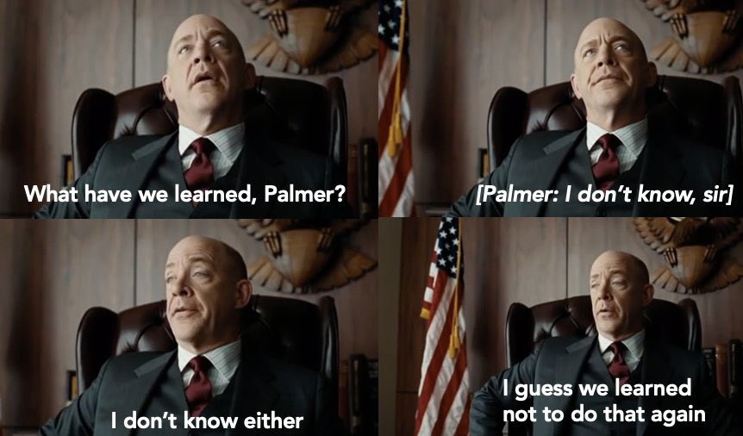
Notes:
I’ve taken the lessons I learned from this matter and applied it to great effect since

Slide 19
Today/Before Something Happens
Start liability and risk training today!
Create a culture of accountability and consequences
  Do what you need to do to get rid of poor performing employees (probation, buyouts, discipline if necessary)
Build a relationship with your departments
Review Policies :
  Supervisor responsibilities
  Employment Appeals
Ask questions

Slide 20
When Something Happens
Contact City Attorney Immediately
Contact URMA and arrange Outside Counsel before claim
Investigate Claims Quickly
Get Public Relations briefed and on top of the message also quickly
  Everyone else shut up Control leaks/rumors
  Don’t create records you don’t need

Slide 21
After Something Happens
AAR
Never let a good crisis go to waste
Training
Policy
Processes

Slide 22


