Slide 1
Special Event Insurance:
From the Insurance Industry Perspective
Presented by: Rob Oldroyd

Slide 2
DISCUSSION TOPICS
Today’s Agenda: Insurance Carrier Perspective
1 | How insurance carriers view special events
2 | Available Coverages
3 | What events can be covered
4 | Underwriting criteria and information needed
5 | Timeline and process for obtaining coverage

Slide 3
The lonely feeling of being the only “grown-up”
"This is an insurance nightmare!"
https://www.youtube.com/shorts/KXc8FwlmR6c

Slide 4
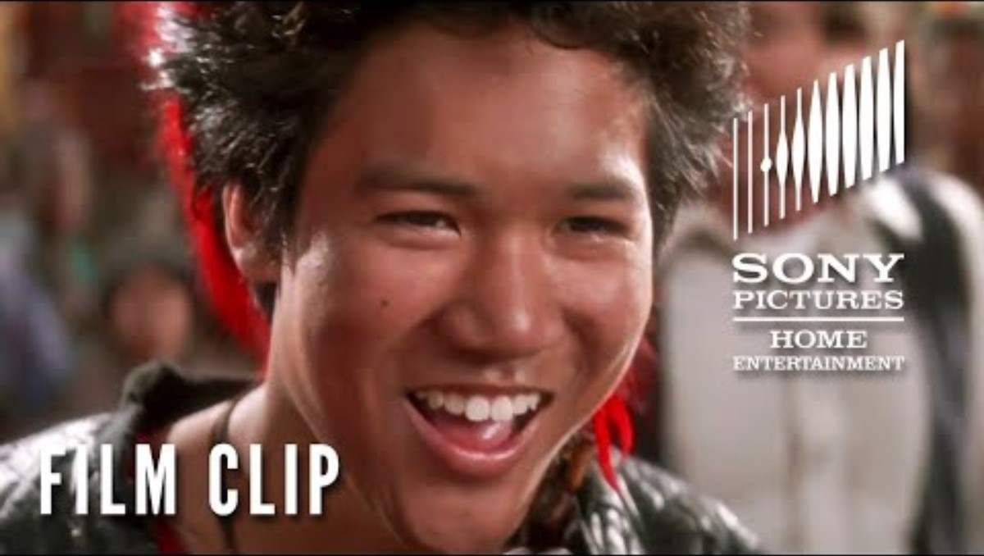

Slide 5
How Insurance Carriers View Special Events
  Special events represent a distinct risk category:
  Concentrated exposure: Large groups in temporary settings
  Variable control: Third-party vendors, contractors, participants, etc.
  Time-limited nature: One-time or infrequent occurrences
  Elevated activities: Non-routine operations (alcohol, entertainment, sports)
  Infrastructure variations: Temporary structures, equipment, setups

Slide 6
Types of Special Event Policies Available
Single Event Policies
One-time coverage for a specific event Short-term (1 day to 1 week typically) Event-specific limits & terms Most common for municipalities
Annual Special Events Programs
Multiple events under one policy 12-month policy period Pre-scheduled or ad-hoc events Often more cost-effective for frequent events
Seasonal/Series Policies
Coverage for event series (e.g., concert series) Defined season or timeframe Similar events with a consistent risk profile Simplified administration

Slide 7
What Types of Events Can Be Covered?
  Commonly Insured Events
  Community festivals and fairs
  5K races, marathons, fun runs
  Concerts and performances
  Holiday celebrations and parades
  Farmers’ markets and craft shows
  Outdoor movie nights
  Sporting tournaments
  The Hunger Games
  Underwriting Considerations
  Expected attendance
  Event activities and attractions
  Alcohol service (Yes/No)
  Professional vs. amateur participants
  Water activities or high-risk elements
  Venue type and conditions
  Prior loss history

Slide 8
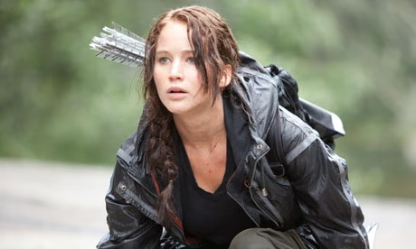

Slide 9
Coverage Options in Special Event Policies
  Standard Coverages Typically Available:
    General Liability
      Bodily injury and property damage arising from event operations
    Legal Defense
      Defense costs for covered claims, even if the allegations are groundless
    Products/Completed Operations
      Coverage for incidents related to food, beverages, or activities
    Liquor Liability
      Alcohol-related incidents (if applicable)—often requires separate coverage
    Additional Insured Coverage
      Extends coverage to venues, sponsors, and vendors as required by contract

Slide 10
Limitless Limiting by Limiting Limits:
  Tort Cap on liability is $911,300 per person and $3,668,400 aggregate per occurrence.
  For claims falling under qualified immunity, the city needs up to a $4M limit. For claims that do not fall under qualified immunity, the limit may need to be higher.
  Standard minimum limit for special event policies is $1M occurrence.
  Many vendors carry minimal limits of $1M occurrence / $2M annual aggregate.
  Vendors should carry the same limits as the city if possible.
  Liquor liability: Usually matches GL limits when purchased.

Slide 11
Information Required for Underwriting:
What carriers need to quote & bind coverage
  Basic Information
  Event name and date
  Event location/venue
  Expected attendance
  Detailed event description
  Activities and attractions
  Alcohol served? (Yes/No)
  Named insured (city/entity)
  Additional insureds needed
  May Also Require
  Vendor/contractor information
  Safety/security measures in place
  Prior loss history (if any)
  Venue lease/contract requirements
  Participant waivers (for certain events)
  Event permits and approvals

Slide 12
Underwriting Process
What exciting things happen once I send my special event to Moreton?
1
Day 0
Submission: City submits event information & application.
7 – 14 Days
Quote: Carrier reviews & provides a quote/terms.
14-21 Days
Binding: Acceptance & payment binds coverage.
21-23 Days
Certificate: Certificate of insurance issued.
2
3
4
5
The rest of your Days
Everlasting joy: You feel good knowing that you did the right thing

Slide 13

✓ Recommended: 2-4 Weeks Before The Event
Allows time for proper underwriting review
Avoids rush fees or limited carrier availability
Enables negotiation of terms if needed
Best Practices: When to Secure Coverage
⚠ Acceptable: 3-7 Days Before The Event
May limit carrier options
Could result in higher premiums
Less time to address underwriting questions
✗ Not Recommended: Last-Minute (< 3 Days)
Coverage may not be available or may be declined by carriers

Slide 14
Common Policy Exclusions to Be Aware of
  Standard exclusions found in most special event policies:
  Professional liability/errors & omissions
  Workers' compensation (employee injuries)
  Pollution/environmental damage
  Intentional acts or criminal activity
  War, terrorism (sometimes can be added)
  Cyber liability/data breaches
  Aircraft, watercraft, autos (except incidental)
  Pre-existing property damage
  Communicable disease (varies by carrier)
  Certain extreme sports/high-risk activities

Slide 15
What Affects the Cost of Coverage?
  Key rating factors carriers use:
  Attendance
  Larger crowds = higher premium
  Event Type/Activities
  Risk level varies (concert vs. farmer's market)
  Alcohol Service
  Significantly increases the premium if alcohol is served
  Coverage Limits
  Higher limits = higher premium
  Duration
  Multi-day events cost more than single-day events
  Venue
  Indoor vs. outdoor, public vs. private property
  Claims History
  Prior claims can impact pricing
  Risk Controls
  Security and safety measures may reduce costs
Typical range for municipal events: $750 – $10,000 per event depending on the exposures

Slide 16
Additional Insured Coverage:
Understanding additional insured endorsements
  What is an Additional Insured?
  A party (other than the named insured) who is granted coverage under the policy for liability arising from the event. Commonly required by venues, sponsors, or contracts.
  Common Additional Insureds for Municipal Events:
  Venue owners (parks, fairgrounds, private property owners)
  Event sponsors or co-sponsors
  Vendors and contractors (by contract)
  County or state entities (if using public land)
  Volunteer organizations involved in the event

Slide 17
Certificate of Insurance (COI):
What it is & why it matters
  Purpose of COI:
  Proof of insurance coverage
  Required by venues, sponsors, contracts
  Shows coverage dates and limits
  Lists additional insureds
  Not the policy itself (summary only)
  What's on the COI:
  Named insured (your city)
  Policy number and dates
  Coverage types and limits
  Certificate holder (venue, etc.)
  Additional insured status
  Event description
Typical turnaround: 1-2 business days after binding

Slide 18
Key Takeaways
  Special event policies provide targeted coverage for time-limited, elevated-risk events
  Multiple policy types available: single event, annual programs, seasonal coverage
  Coverage options include GL, medical payments, liquor liability, and additional insureds
  Typical timeline: 2 – 3 weeks; best practice is to submit 2 – 4 weeks before the event
  Cost varies based on attendance, activities, alcohol, venue, and other risk factors
  Certificates of insurance issued for venues, sponsors, and contract requirements

Slide 19

THANK YOU
Questions
& Answers

