Slide 1

HOT BUTTON TOPICS
A View from the Front Lines

Slide 2

Quick Hits!
Negligent Hiring & Training
Map the System
Lights & Sirens Immunity
Gardner Decision
Closed Sessions

Slide 3
Loudermill Issue

Slide 4


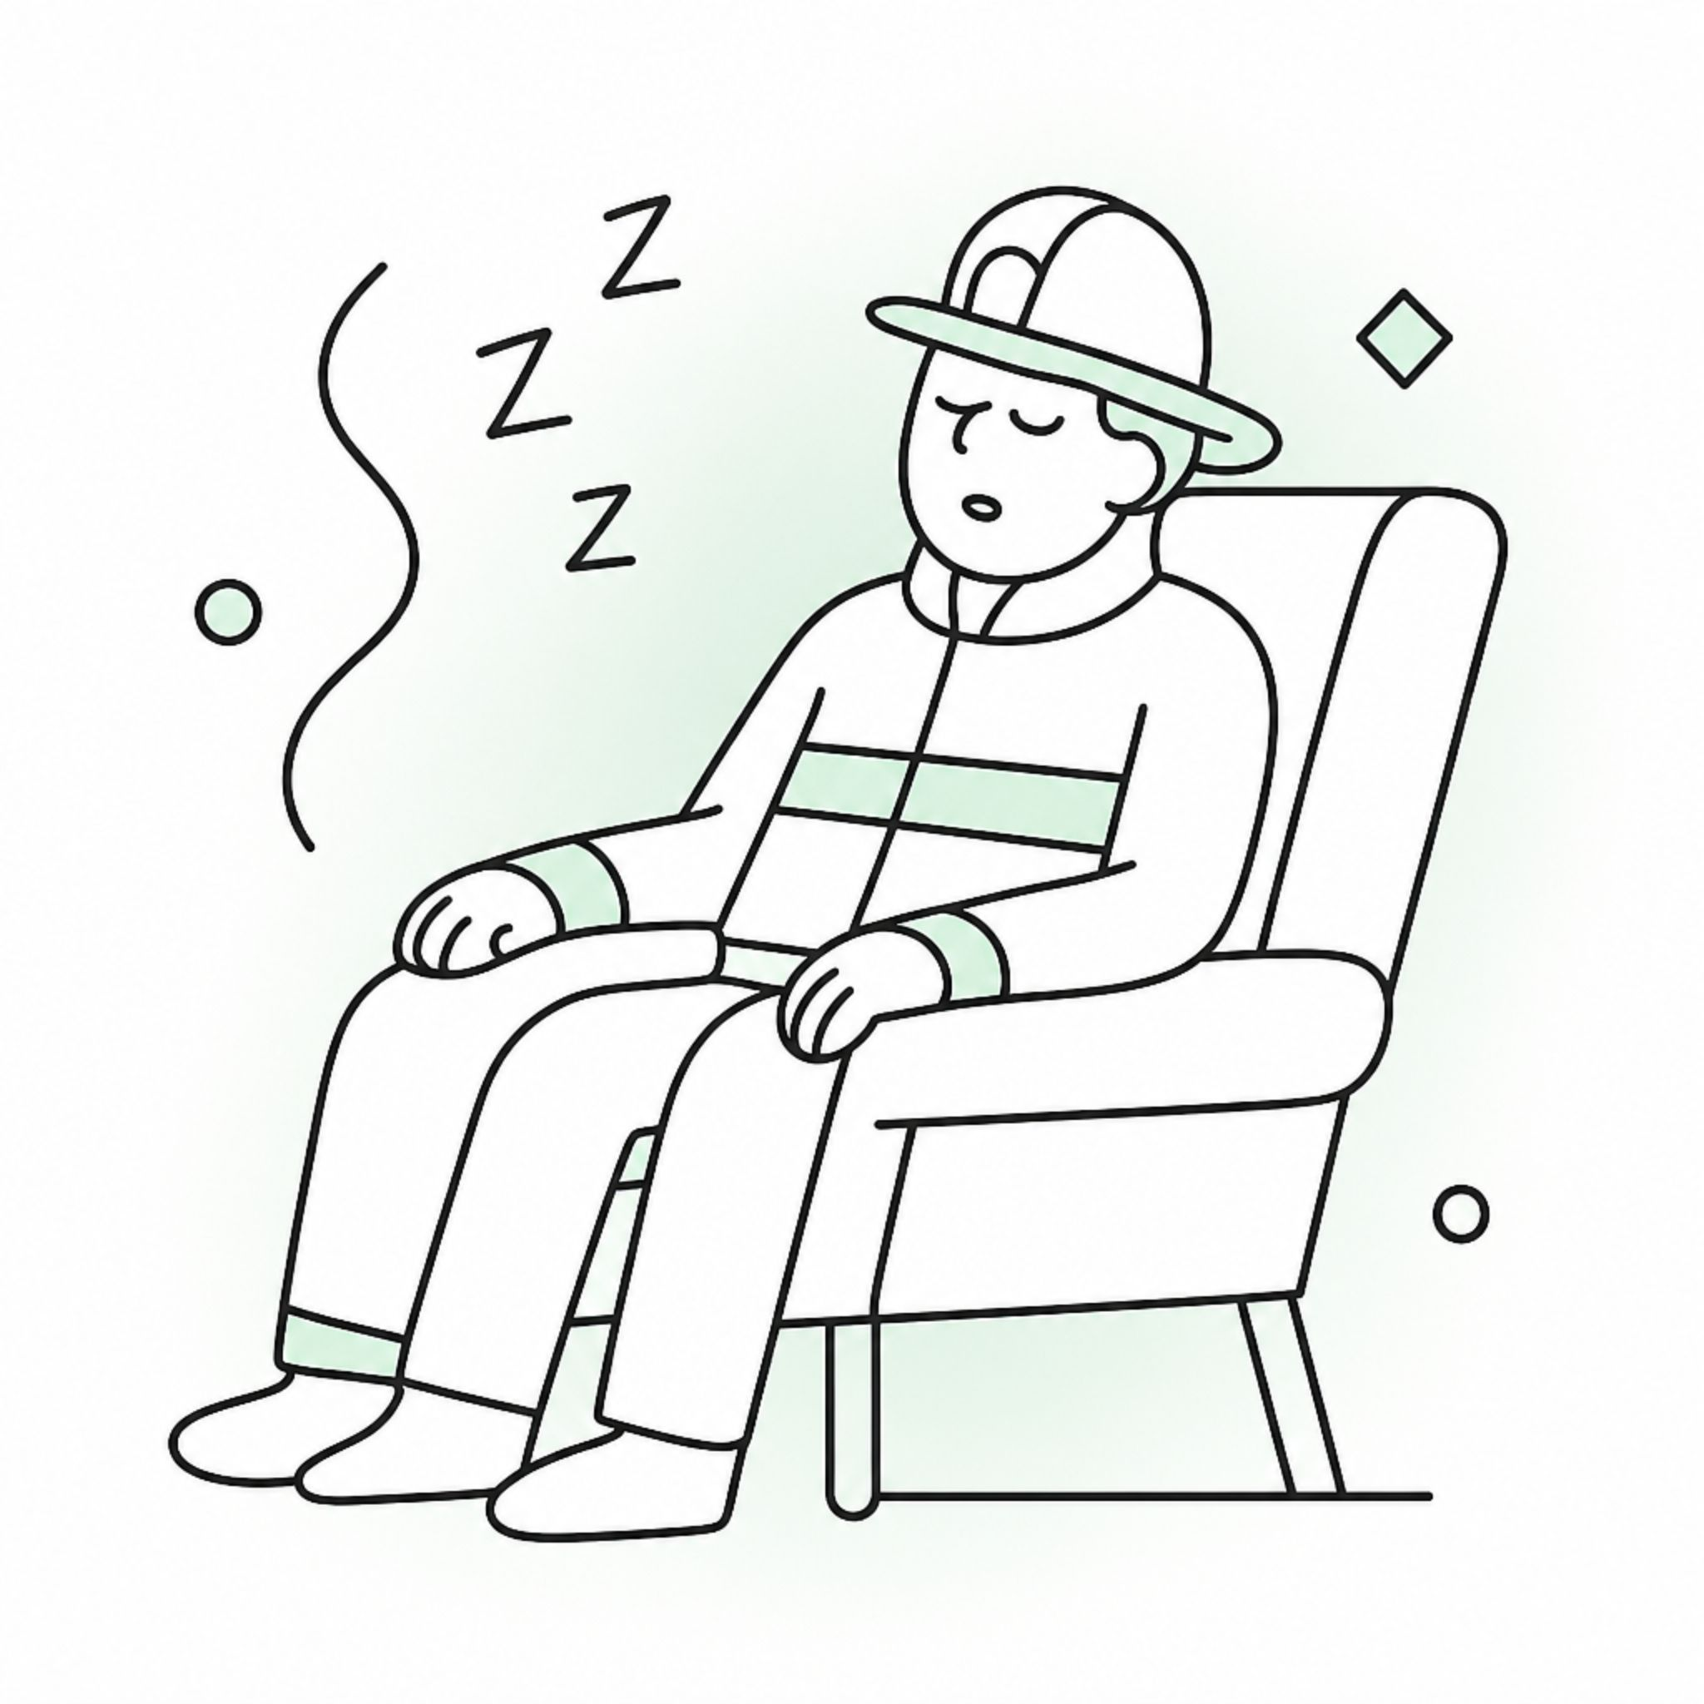



Proposed Discipline
Employee found asleep in the recliner while at work.
Poor performer.
Proposed penalty: 3-day suspension without pay.
Pre-Determination Hearing
Employee volunteers he was asleep because of a new prescription pain medication he was taking for a shoulder injury. He reveals he's been taking it for several weeks and is still getting used to it.
Chief Investigates
Employee works in a "safety sensitive position."
Chief discovers in the last several weeks employee has worked regular shifts and responded to emergencies, etc.
Discipline Decision
Chief decides to terminate the employee. Sends notice and details policy violation for taking prescription drugs while at work, responding to emergencies while impaired, and sleeping on the job.

Slide 5
At the Post-Deprivation Appeal…
The drug was prescribed by a doctor and legal.
Employee's doctor had cleared him to return to work.
Employee had reported the prescription to his direct supervisor, who failed to log it.

Slide 6
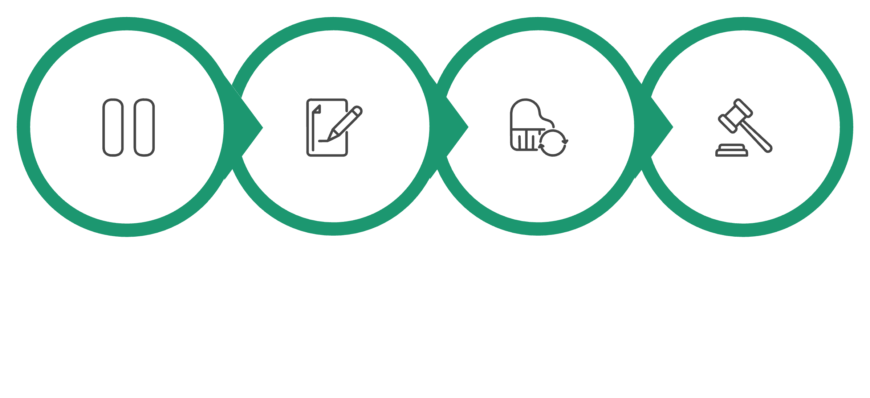
The Fix
Amend Notice
Pause
New Meeting
Decide
Due Process
ADA
FMLA
New grounds require new notice
Disclosed medication triggers interactive process
Same disclosure can trigger notice duties

Slide 7
Words Matter

Slide 8
"Aspirational Language"
Problematic Use
Improved Language
"Safety is our top priority."
"We take safety seriously and work to keep our facilities in good shape.
"We will ensure that every employee is fully trained on all hazards."
"Employees receive training appropriate for their jobs."
"The City has a zero tolerance policy for any harassment."
"The City prohibits harassment and takes complaints seriously."
"We verify references for all applicants before hiring."
"We may verify references as part of our hiring process."

Slide 9
"Hazard"
Problematic Use
Improved Language
Sidewalk inspection note: "Hazard at 326 Main Street."
"Displacement at 326 Main Street."
Public works policy: "The City will inspect annually and note all hazards in the system."
"The City will inspect annually and note all defects in the system."
Playground work order: "Chain on the swing is a safety hazard, needs to be replaced."
"Chain on the swing is worn, needs to be replaced."

Slide 10
"Fault"
Problematic Use
Improved Language
Accident Review Committee: "Smith caused this accident by not following policy."
"Smith did not complete required pre-shift inspection."
Post-incident report: "Our driver was at fault by failing to yield to the pedestrian."
"Our driver appears to have failed to yield to the pedestrian."
"If we had fixed this issue earlier, she wouldn't have fallen."
"The issue was repaired after the incident. Inspection timing is under review."

Slide 11
Spoliation

Slide 12
Spoliation is the destruction, alteration, or failure to preserve evidence that is relevant to pending or reasonably foreseeable litigation.
What qualifies as evidence?
What evidence is relevant?
What does reasonably foreseeable litigation mean?
What happens if you don't preserve?

Slide 13







"Evidence"
Documents and Physical Records
Electronic Communications
Digital Files and Data
Audio and Visual
Physical Evidence and the Scene Itself
Third-Party and Cloud-Held Data

Slide 14
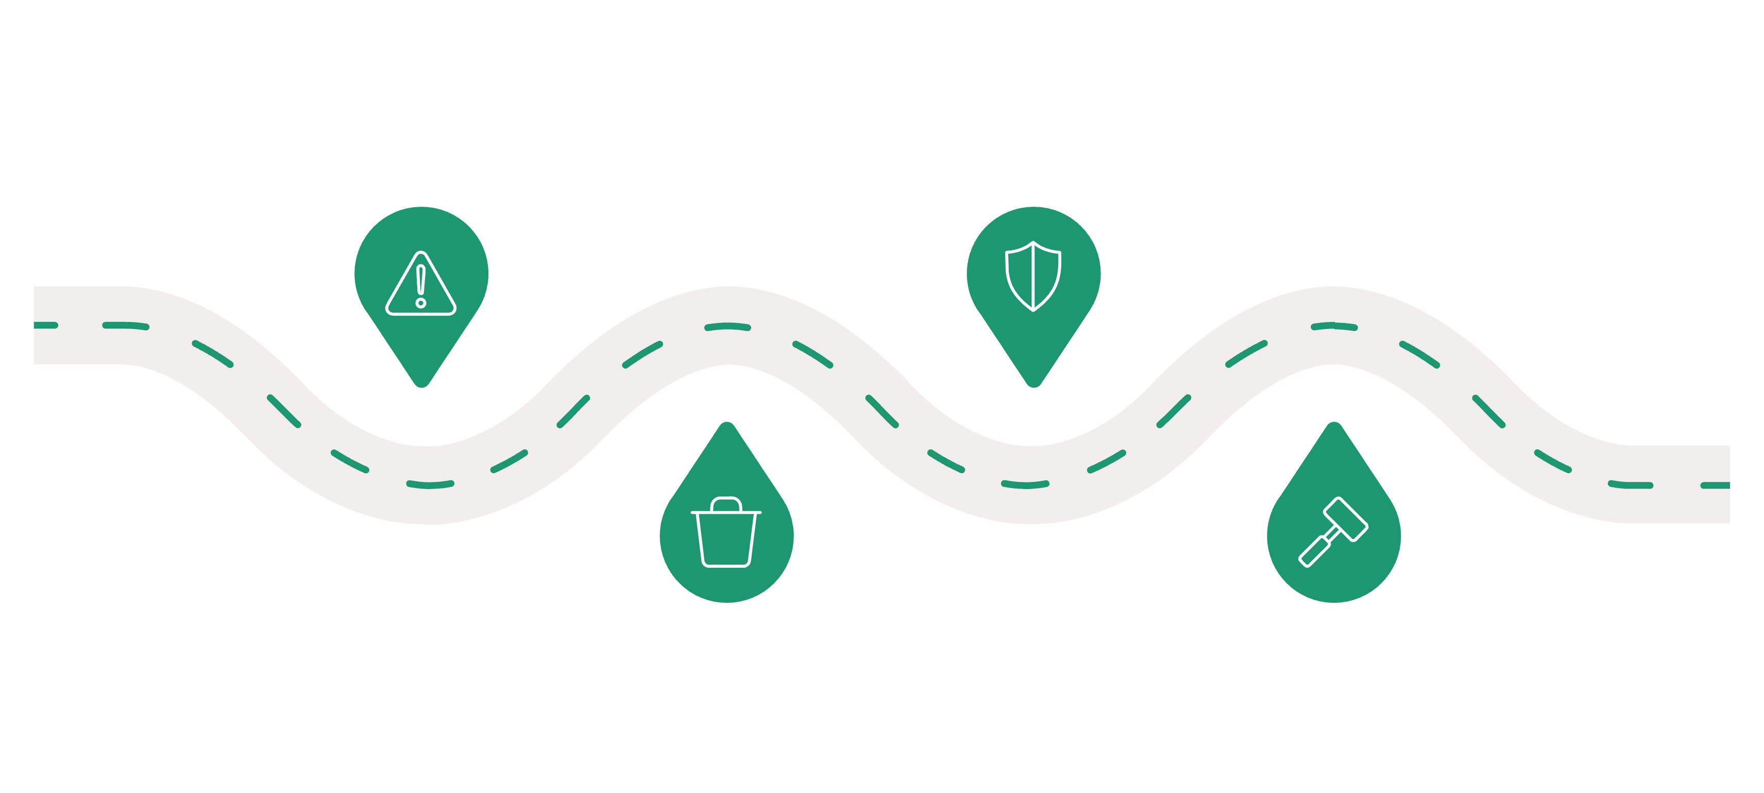
Preservation Letter
Incident
Overwrite
Lawsuit

Slide 15
Reasonableness is the standard, not perfection
Preserve at foreseeability, not at filing
Know your retention and auto-purge schedules
Send written litigation hold letters
Suspend auto-delete immediately
Grab short-cycle footage first, inside its window
Preserve the physical scene with photographs
Never edit or clean up records after the fact
Involve counsel early
Document what you preserved and when

