Slide 1

BY THE NUMBERS
Summer Conference 2026
Utah Risk Management Agency

Slide 2

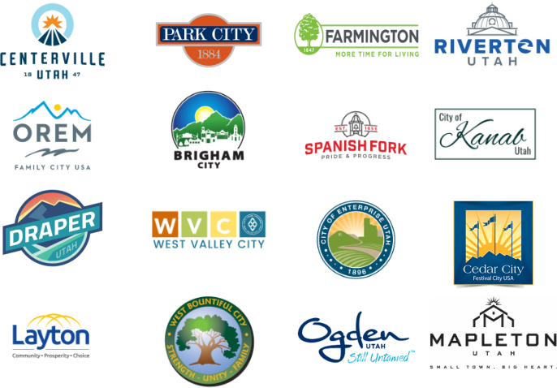
16 Members
URMA | BY THE NUMBERS
2

Slide 3

History
Created September 30, 1985 — 40 years, 10 months
Early Members
12 cities
1985 – 1987 · URMA’s original member cities
31
West Valley City
9/30/1985
Ogden
10/1/1985
Orem
10/1/1985
Spanish Fork
10/1/1985
Draper
10/1/1985
Centerville
1/1/1986
Brigham City
7/4/1986
Mapleton
7/19/1986
cities have been URMA members throughout its history
Layton
8/1/1986
Kanab
8/1/1986
Enterprise
9/4/1986
Cedar City
3/1/1987
40 yr
Recent Additions
4 cities
2002 – 2025 · cities that joined URMA later
10 months since URMA’s founding in 1985
Farmington
9/1/2002
West Bountiful
7/1/2017
Park City
1/1/2024
Riverton
7/1/2025
URMA | BY THE NUMBERS
3

Slide 4

Overview
16
6.27%
4 of 10
700,704
Member cities
of Utah’s approximately 255 cities
of Utah’s largest cities are URMA members (40%)
residents served — 20% of Utah’s population
URMA | BY THE NUMBERS
4

Slide 5

Claims & Litigation
Five-year trend across all member cities
Claims Filed
Litigation Filed
383
18,108
average claims per year
total claims in the history of URMA
URMA | BY THE NUMBERS
5

Slide 6
Litigation
Active litigation across all member cities by defense attorney
URMA | BY THE NUMBERS
6

Slide 7

Settlements
Settlements paid by fiscal year
$10.98M
five-year total settlements paid
$46.97M
total settlements paid in the history of URMA
URMA | BY THE NUMBERS
8

Slide 8
URMA Shared Loss History
$1.09M
five-year total shared loss
$6.17M
total paid shared loss in URMA’s history since 2005
URMA | BY THE NUMBERS
9

Slide 9

URMA APDP
Self-insured Auto Physical Damage Program
Vehicles Enrolled (Covered)
Program Terms
$270 premium per vehicle
$5,000 deductible
$50,000 coverage limit
987
$1.17M
average vehicles covered per year
program history claims paid out
URMA | BY THE NUMBERS
10

Slide 10
Repayment Program
Self-insured program repayments by year, minus shared losses
* FY 26-27 is the current year. 5-year average: $2,142,450
URMA | BY THE NUMBERS
11

Slide 11
Subrogation & Recovery
Program implemented in 2023
$474,427
cumulative total recovered since 2023
URMA | BY THE NUMBERS
12

Slide 12
Group Cost Discounts
Liability Insurance — Great American
Coverage Structure
Retention + $6M limit ($375,000 / $827,000 / $1,000,000 retention)
Additional $2M for law-enforcement liability
Competing Quotes
Most unable to compete with Great American
Old Republic: $1,242,436 with $5M limit (about 30% higher)
URMA | BY THE NUMBERS
13

Slide 13
Group Cost Discounts
Lexipol — Policy Support for Police, Fire & HR
15% group discount
≈ $59,947 saved vs. individual purchase
URMA | BY THE NUMBERS
14

Slide 14
Group Cost Discounts
Risk Management Information System — Origami
URMA Group Cost (all cities)
Individual Cost Without URMA (Annual)
25,000 population city — $69,500
50,000 population city — $89,150
100,000 population city — $140,650
URMA | BY THE NUMBERS
15

Slide 15
Group Cost Discounts
Property Insurance Program Premiums — AFM
12%
below FM Global standardized underwriting criteria (2025)
$357,721
group purchase savings, FY 2026-27
$1.08M
total savings over 5 years
URMA | BY THE NUMBERS
16

Slide 16
Group Cost Discounts
Cyber Risk Insurance — $3M per incident / $15M aggregate
$2.17M
total cost since 2016
$1.47M
URMA shared cost since 2016
Member cities are no longer able to purchase this coverage independently.
URMA | BY THE NUMBERS
17

Slide 17
Loss Prevention — Risk Scores
Collective Loss Control Inspection Program
98.52%
5-year average risk score
URMA | BY THE NUMBERS
18

Slide 18
Risk Consultations
Enterprise Risk Management — Proactive Risk Management
398
5-year average consultations per year
URMA | BY THE NUMBERS
19

Slide 19
URMA Training
1,107
1,472
25 / yr
Online course titles available (LocalGovU & Lexipol)
On-line training (5-year average)
in-person trainings provided (5-year average)
Online Completions per Year
In-Person Sessions per Year
URMA | BY THE NUMBERS
20

Slide 20
Summary — Savings by City Size
Estimated overall annual savings from group purchasing & shared expenses
25,000 population city
50,000 population city
100,000 population city
$549,246
$879,566
$1,281,432
Property
12%
General Liability
8–16%
Heavy Vehicle Auto
7%
OD Auto
4%
Lexipol
15%
Origami RMIS
93%
Claims & Litigation Mgmt
54%
Legal Fee Discounts
15–20%
Insurance Brokerage
11%
Based on averages, standard underwriting criteria, quotes from other or same providers, and specific industry and market rates.
URMA | BY THE NUMBERS
21

Slide 21




How URMA Works
Promote Good Practice
Share Expenses
Purchase as a Group
Reduce Costs
Promoting good risk management principles & practices
Sharing risk management service expenses across all member cities
Group purchasing of discounted insurance coverages
Reducing overall risk management costs to every member city
URMA | BY THE NUMBERS
22

