Slide 1


SAFEGUARDING TRUST:
REPUTATIONAL RISK IN LAW ENFORCEMENT
Chief Chad Reyes
Brigham City Police Department
Notes:
Intro/bio.

Slide 2
INTRODUCTION
What is Police Reputation?
Agency’s most valuable asset.
The public's perception of a law enforcement agency.
Built through daily interactions, professionalism, accountability, and transparency.
Strong reputations increase public cooperation and support, officer safety and effectiveness, and recruiting and retention.
Notes:
Reputation takes decades to build, but only seconds to destroy, especially in the digital age.
Reputational risk is the potential for negative public perception to erode institutional legitimacy, community trust and operational effectiveness.

Slide 3
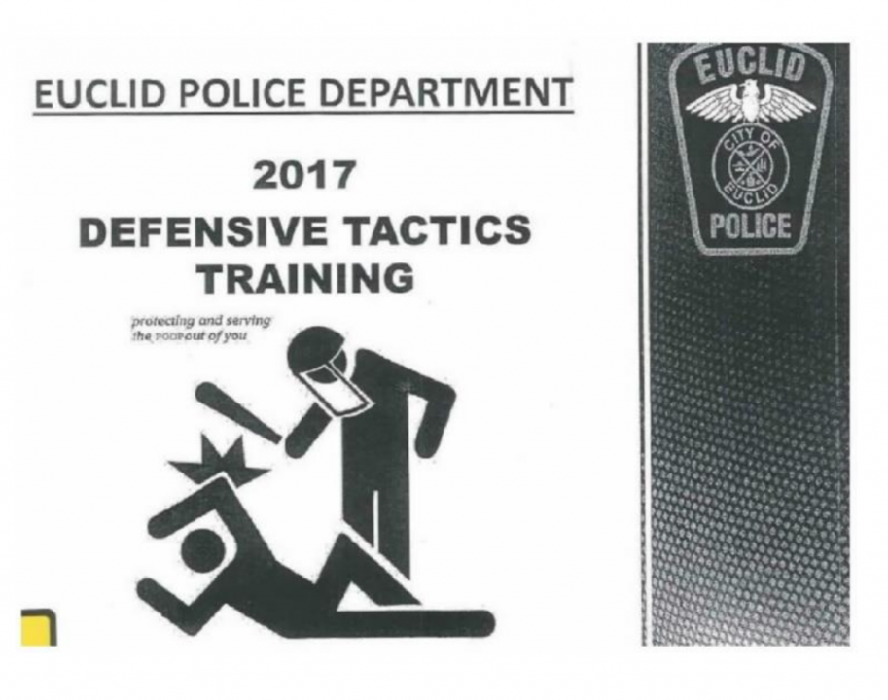
Everything is public
Notes:
Horrible department sponsored graphic. Everyone loves a scandal, even your own officers, which could easily leak this to the media.

Slide 4
USE OF FORCE AND REPUTATION
  Key Points
  Force should only be lawful, necessary, and proportional.
  Excessive or unnecessary force damages public confidence.
  Proper training and accountability improve trust.
  Body-worn cameras can provide greater transparency.
    Impact
    Reduced community trust and cooperation.
    Increased complaints and lawsuits.
    Lower officer morale (Esprit de Corps), recruiting/retention.
    Greater public scrutiny. Costly Mistakes
Notes:
Training and good policy (not allowing for taser to be carried on the same side as firearm) is crucial.

Slide 5
UNPROFESSIONAL CONDUCT
Examples
Disrespectful treatment of citizens.
Bias or discrimination.
Dishonesty.
Misuse of authority.
Social media misconduct.
Consequences
Loss of credibility.
Increased public complaints.
Internal disciplinary actions.
Damaged community relationships.

Slide 6
Failure to Address Violation
When Misconduct Goes Unaddressed
Failure to investigate complaints.
Inconsistent discipline.
Protecting officers from accountability.
Ignoring policy violations.
Effects
Creates a perception of favoritism.
Misconduct becomes new norm.
Encourages unethical behavior.
Weakens public confidence.
Damages organizational culture.
90 mph

Slide 7
FAILURE TO ADDRESS VIOLATIONS (cont.)
Small Corrections early VS Large problems later
Importance of First Line Supervisors
Deviation becomes the allowed norm
Good policy and accountability
LANGUAGE!
Notes:
A pattern or tolerating minor policy violations informally changes your policy and sets the new norm. Frequent small corrections helps prevent the need for large corrections and crises later.
“Failure to supervise” is one of the most significant liability exposures for police departments.
Professionalism and language are too often dismissed.

Slide 8
TRANSPARENCY
Transparency Includes
Open communication.
Timely release of accurate information.
Independent investigations when appropriate.
Public reporting of policies and statistics.
Effects of Poor Transparency
Increased rumors and misinformation.
Public skepticism.
Reduced confidence in investigations.
Greater community tension.
Notes:
If we don’t provide a factual, objective story, people/media will make up their own for fill in the gaps with their imaginations. We control the narrative, not them.
When we really do screw up, it takes courage to be transparent. Holding ourselves accountable builds trust.
Silence is almost always interpreted as “police cover up”.
Why not cultivate a relationship of trust with the media as well as the public. A lot of PD’s still are afraid of the media, but they can be our friends who hold us accountable.

Slide 9
COMMUNITY TRUST
Benefits
Better crime reporting.
Increased victim/witness cooperation.
Improved officer safety.
Stronger public support and partnerships.
Trust is Built Through
Fair and equal treatment.
Courage to be transparent.
Respect.
Consistency.
Accountability.
Positive community engagement.

Slide 10
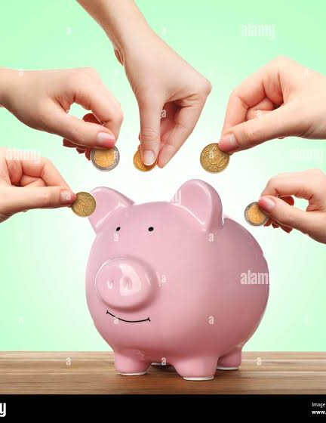
REPUTATION/TRUST ACCOUNT
Trust = Currency
Good things = Deposit
Mistakes/Misconduct = Withdrawals
Some things are bigger withdrawals than others
Strive to ensure you always have a positive balance, because withdrawals are inevitable.

Slide 11
INDUSTRY-WIDE IMPACT POTENTIAL
Good Cop / Bad Cop

