Slide 1
URMA Summer Conference
Risk Identification and Risk Assessment
July 30, 2026

Slide 2

Thank you

Slide 3
outline
Quick Review of Principles, Framework, and Processes
Risk Identification
Risk Analysis
Practice Scenario
Lessons Learned
Questions and Answers

Slide 4

Quick Review

Slide 5
What is risk?
What is risk?
Uncertainty
The effect of uncertainty on the objective, both positive and negative
What is risk management?
Coordinated activities to direct and control an organization with regards to risk
  Principles
  Framework
  Processes

Slide 6
Risk mgmt. principles
Several principles are outlined in ISO31000. Among them are
Risk Management addresses uncertainty
Risk Management is part of decision making
Risk Management is tailored and specific to an organization

Slide 7

Risk mgmt. framework
When you hear risk management framework, think governance
  Design
  Implementation
  Evaluation
  Improvement

Slide 8
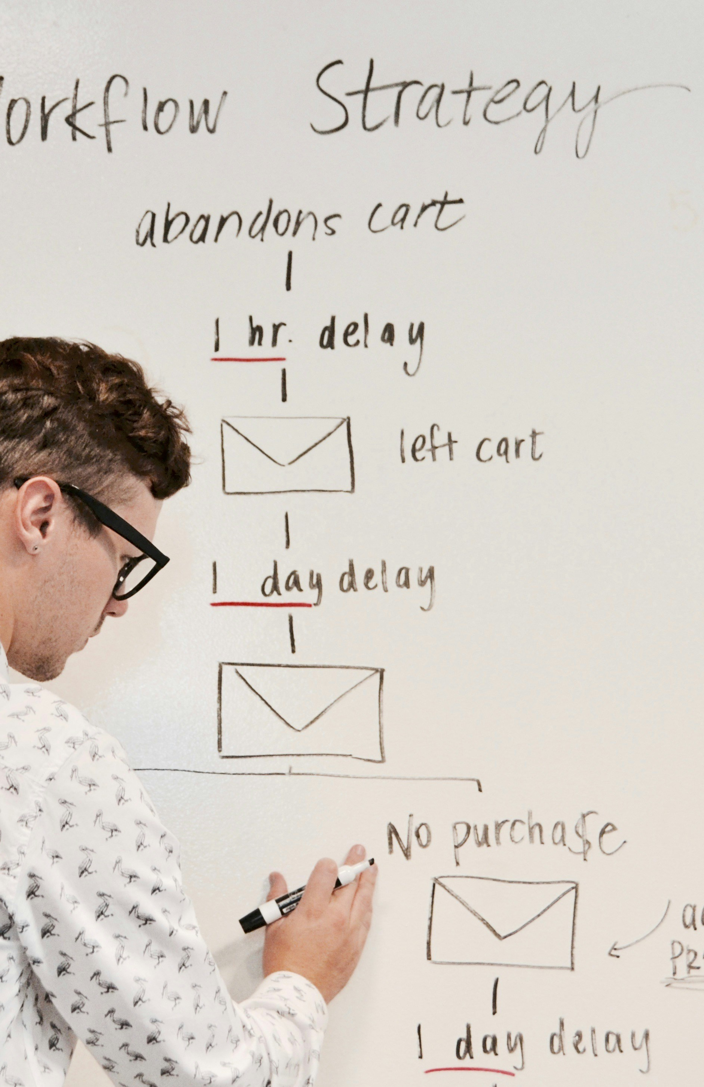
Risk mgmt. process
”Systematic application of management policies, procedures, and practices to the activities of communicating, consulting, establishing the context, and identifying, analyzing, evaluating, treating, monitoring and reviewing risk” ISO31000

Slide 9
Risk Identification

Slide 10
Risk Identification
A process to find, recognize, and describe risks by identifying sources, causes, and consequences
Review contracts, perform assessments and inspections, look at loss data, look ahead to emerging issues, understand compliance points and issues, etc.
Consider what could go wrong, or right, and why?
Identification is not analysis

Slide 11
Risk Identification
What to do after finding a risk
Identify risk types, classes, categories, etc.
Create a risk register or a log
What not to do
Create a risk identification process that is complicated, resource intensive, or doesn’t work
Remember, a risk management program should be tailored to the organization

Slide 12
Risk Assessment

Slide 13
Risk assessment
What is risk assessment?
Overall process to identify, analyze, and evaluate risks
Methods to assess risk
Quantitative assessment-data driven decision making used to give a quantifiable conclusion or identify likelihood and/or impact of a risk
Qualitative-a subjective evaluation to analyze risk based on professional opinion and expertise

Slide 14
Risk assessment
Quantitative risk assessment
You need data not an opinion!
Sometimes a data set isn’t large enough to draw meaningful conclusions
Leverage your brokerage firm and the insurance industry to provide reliable data
Great tool for industrial safety engineering, product safety, budget and forecasting, etc.

Slide 15
Risk assessment
Qualitative risk assessment
Used when data is not available or reliable
Effective for unique situations and circumstances
Requires competent and informed professionals with the right expertise
Requires a well functioning team that can counsel together

Slide 16
Risk assessment
Additional considerations of risk assessment
Many risk assessments require both quantitative and qualitative analysis
When assessing risks look closely at the treatments/controls already in place
  Are they still current?
  Are there single point failures?
  Do they really make a difference?

Slide 17
Risk assessment
Additional considerations of risk assessment
Be careful with qualitative heat mapping of risk
  You may not be hearing from the experts, the process can be easily manipulated or wrong
Correlation is not causation!

Slide 18
Practice Scenario

Slide 19
Practice
Auto liability and auto physical damage
Identify the risks
  Injury or death to first party
  Injury or death to third party
  Damage to first party or third party owned auto
  Compliance issues e.g., driver’s license, insurance requirements, etc.
  Process issues e.g., certificates of insurance, claims management, vehicle repairs, etc.
  Operational concerns e.g., ability or inability to accomplish objectives through other means

Slide 20
Practice
Auto liability and auto physical damage
Assess the risks
  Quantitative-number of vehicles, miles driven, total cost of claims, cost per claim, claims by country or jurisdiction, number of vehicles for hire, how many passengers in vehicle, citations, fines and penalties, miles per fatality, other loss or accident history
  Qualitative-experience of drivers, location, others in the vehicle, immunity, culture of safety, etc.
Controls/treatment
  Policies, procedures, training, monitoring, audits, assessments, etc.

Slide 21
Lessons Learned

Slide 22
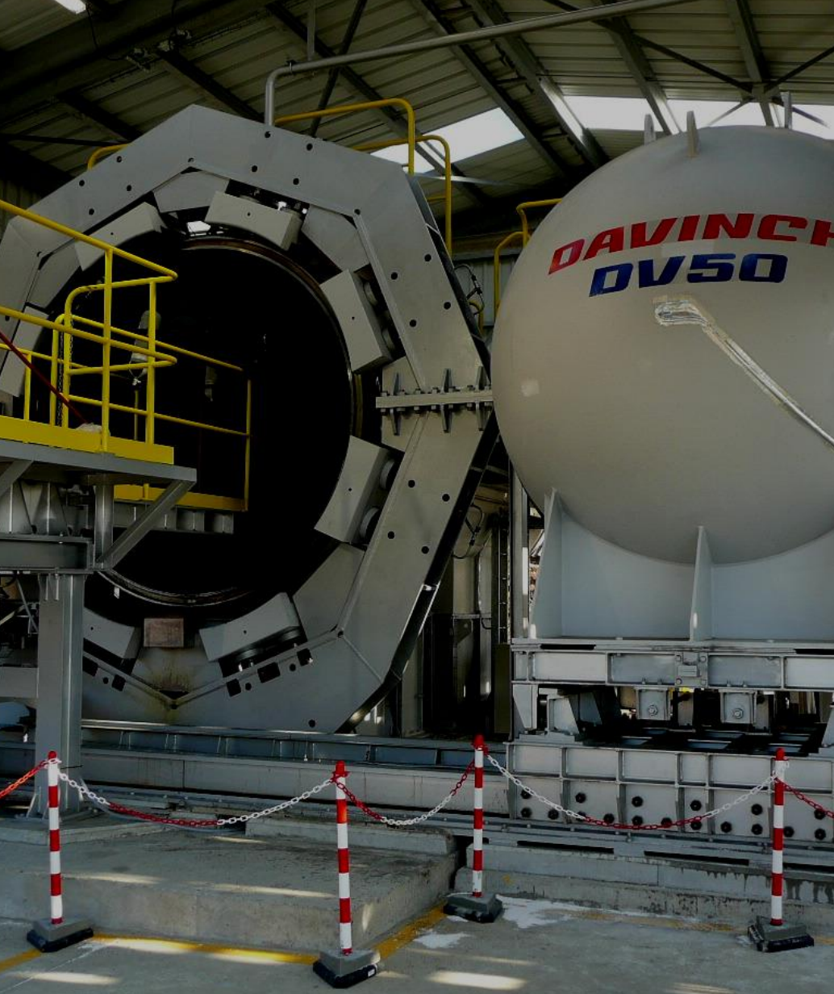
Lessons Learned
Where does the scope of risk identification and assessment begin, and where does it end?
https://www.epa.gov/sites/default/files/2015-03/documents/9545947.pdf

Slide 23

Lessons Learned
Who in the organization needs to be thinking about risk and how risk may impact them or the organization?

