Slide 1
Big Incidents: Things to consider and lessons learned

Slide 2

Roxeanne Vainuku
Deputy Communications Director for West Valley City
Private Consultant
Former Journalist

Slide 3
Incidents That Shaped
My Communications strategy
Line of Duty Death
OICI Where Suspect Was Handcuffed (Round Two)
Importance of internal communication
Importance of asking for help
Sometimes you just have to bite your tongue
Sometimes people just want you to listen
Kill them with kindness
OICI Where Suspect Was Handcuffed
Get in front of bad information with good information
Context is critical

Slide 4
Incidents That Shaped
My Communications strategy
WestFest Shooting
Importance of Planning Ahead
Son Who Stabbed Parents to Death
Protecting People from Media Exposure is Hard
Take Care of Yourself

Slide 5
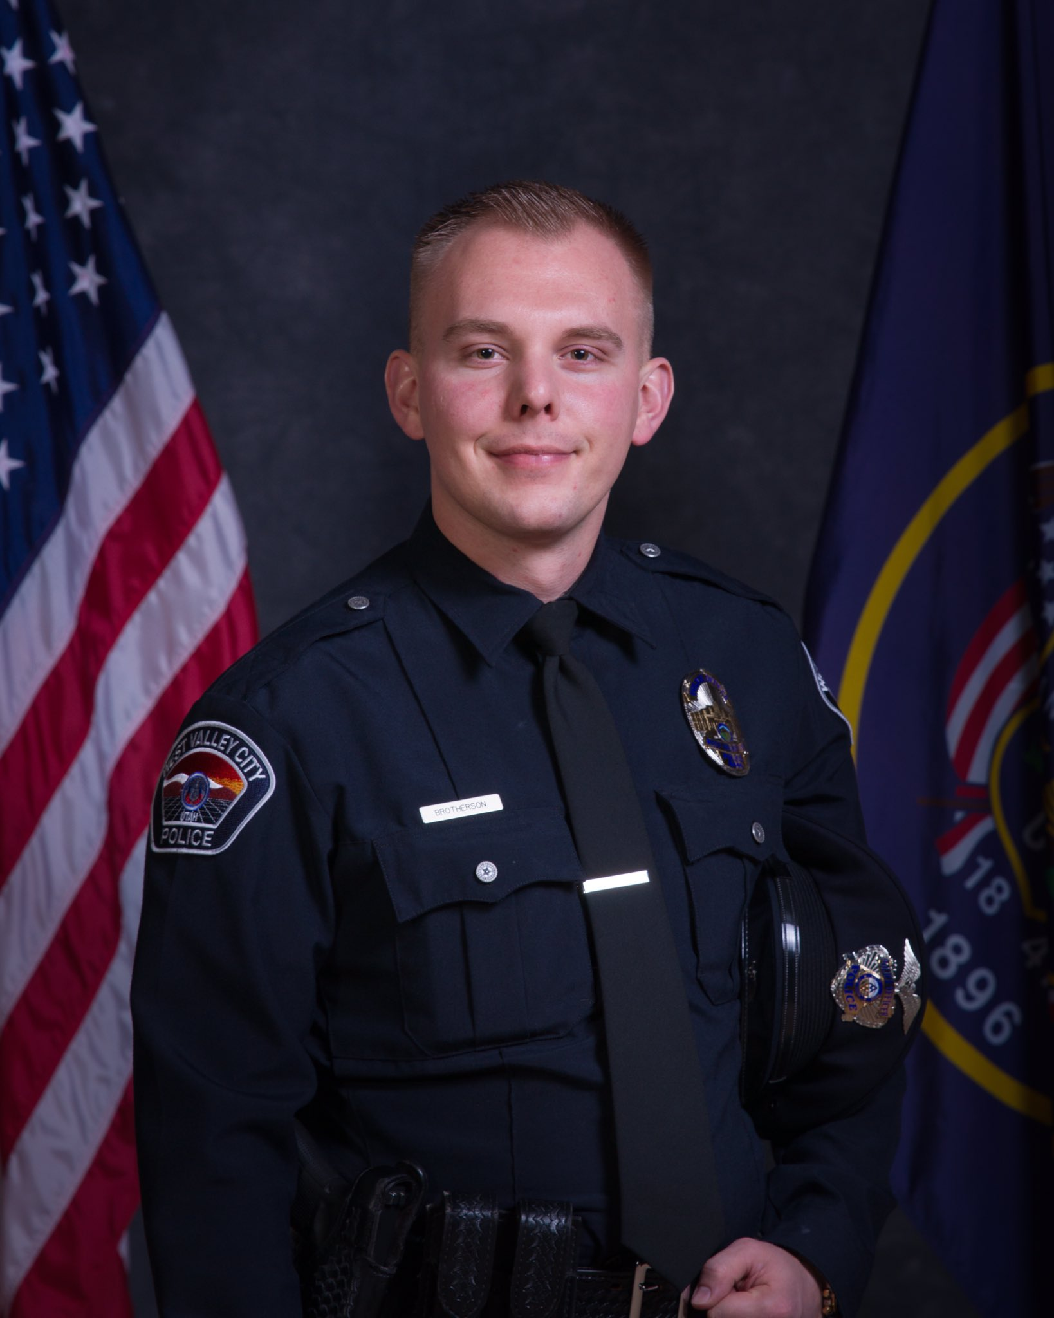
Line of Duty Death
Importance of internal communication
Importance of asking for help
Officer Cody Brotherson

Slide 6
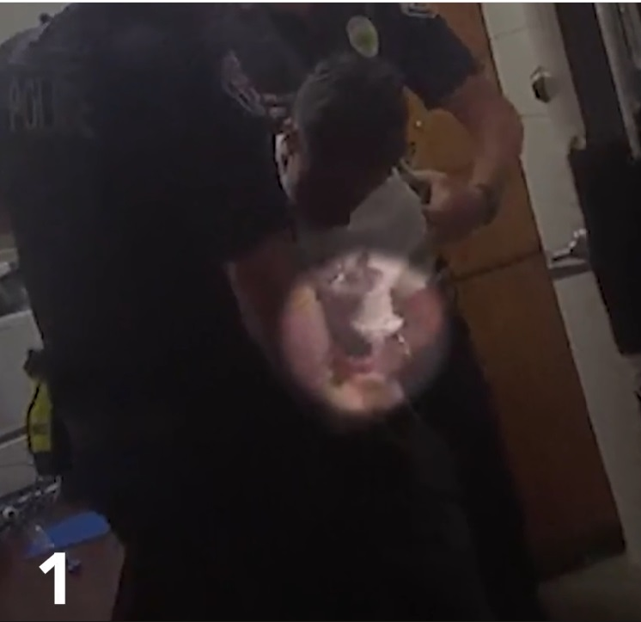
OICI with Suspect in Handcuffs
Get in front of bad information with good information
Context is critical

Slide 7
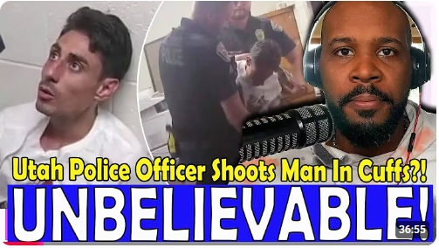
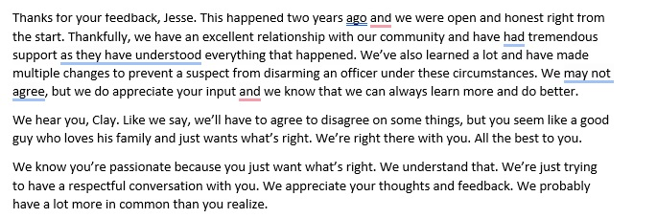
OICI with Suspect in Handcuffs
(Round Two)
Sometimes you just have to bite your tongue
Sometimes people just want you to listen
Kill them with kindness

Slide 8
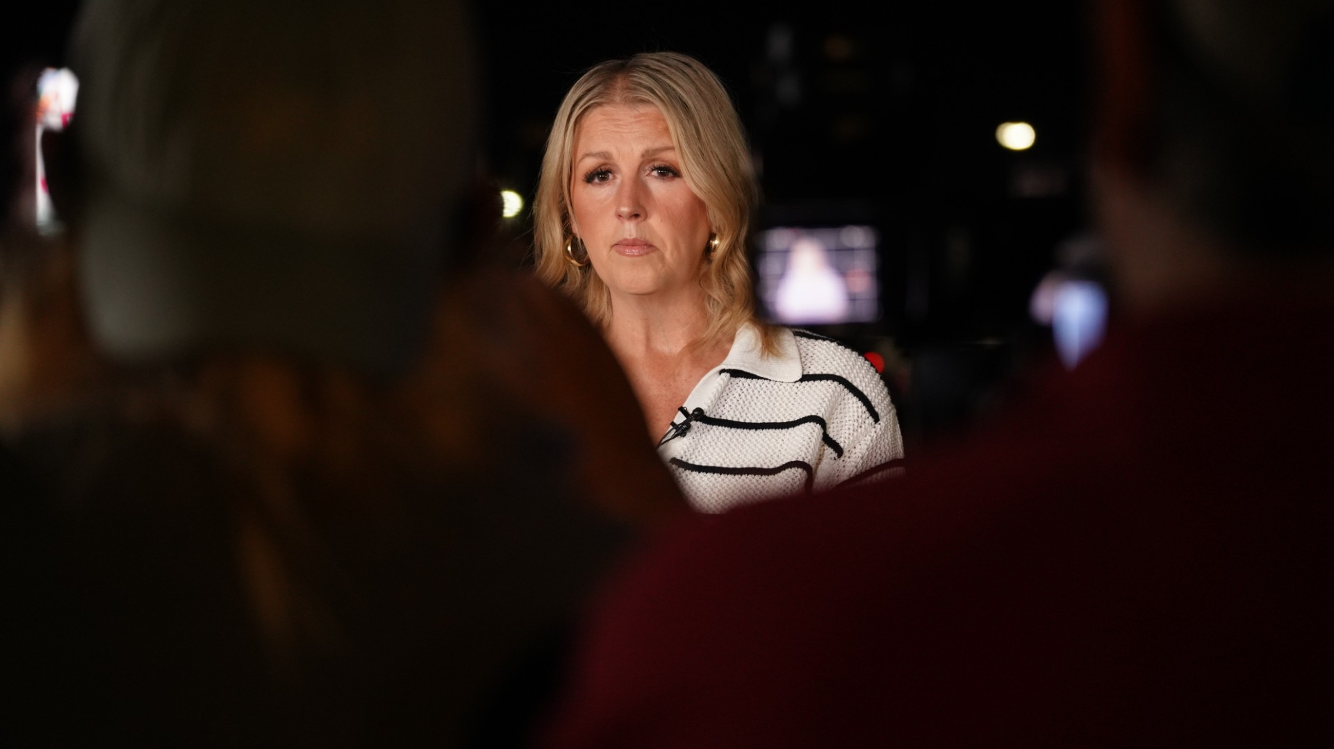
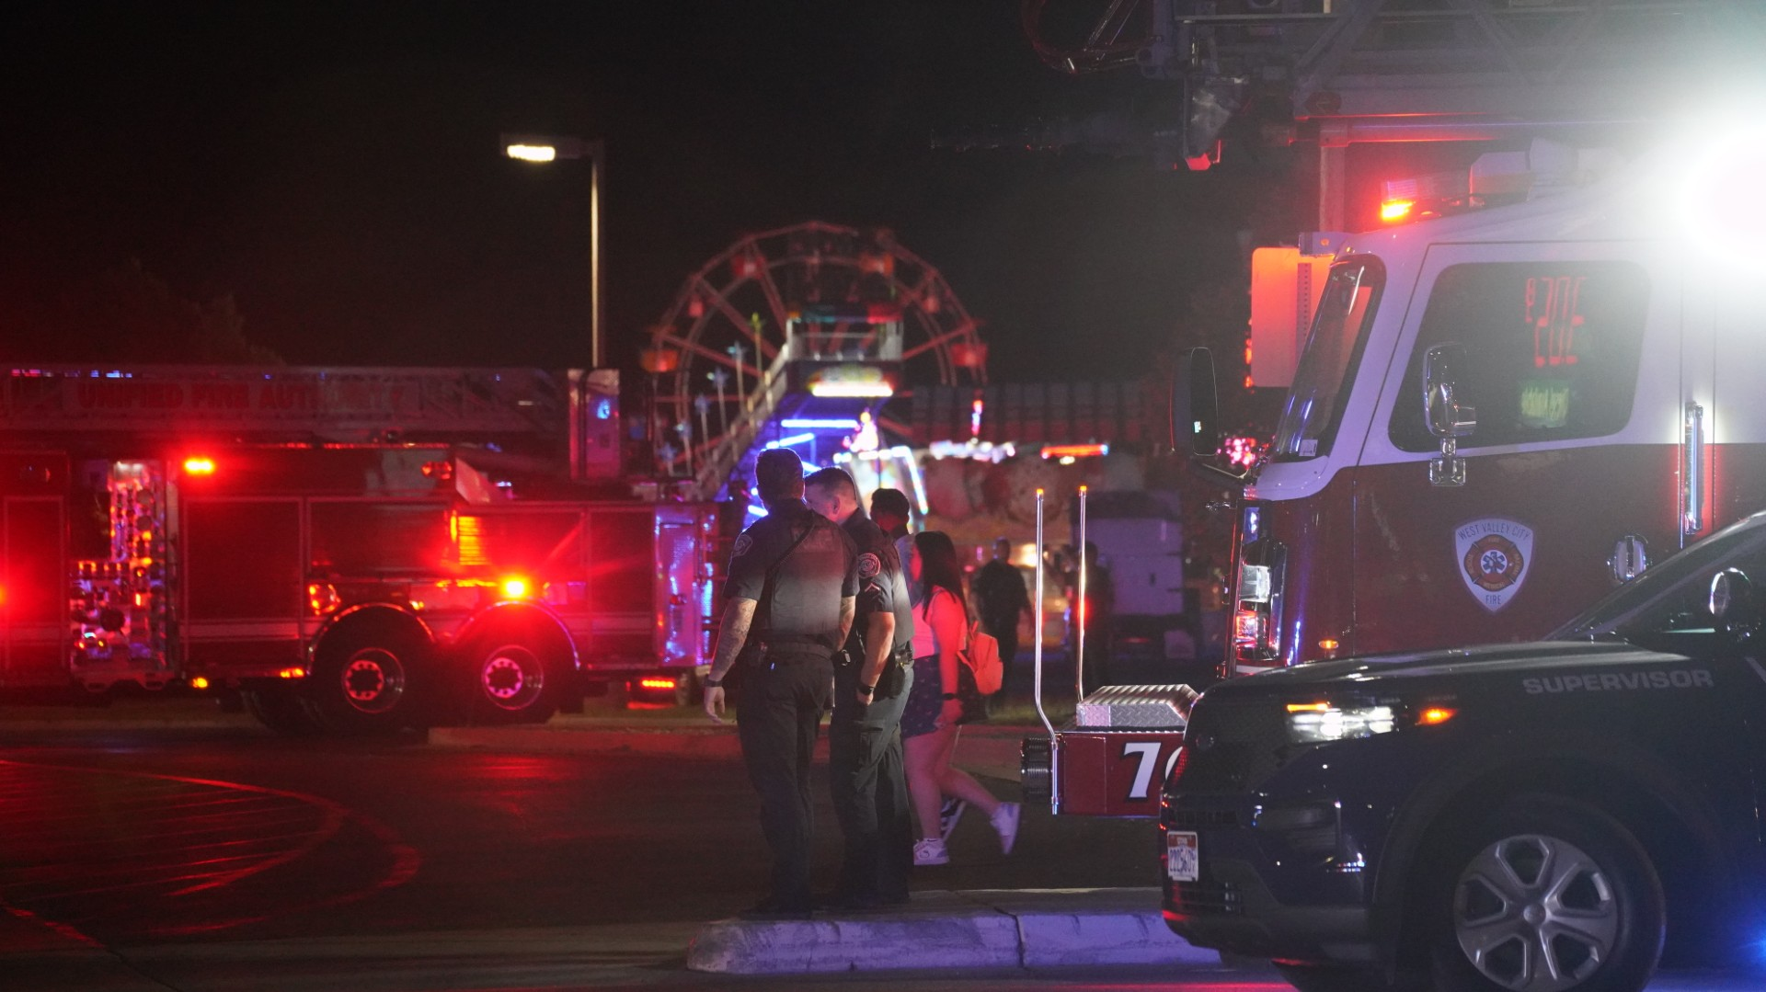
WestFest Shooting
Importance of Planning ahead

Slide 9
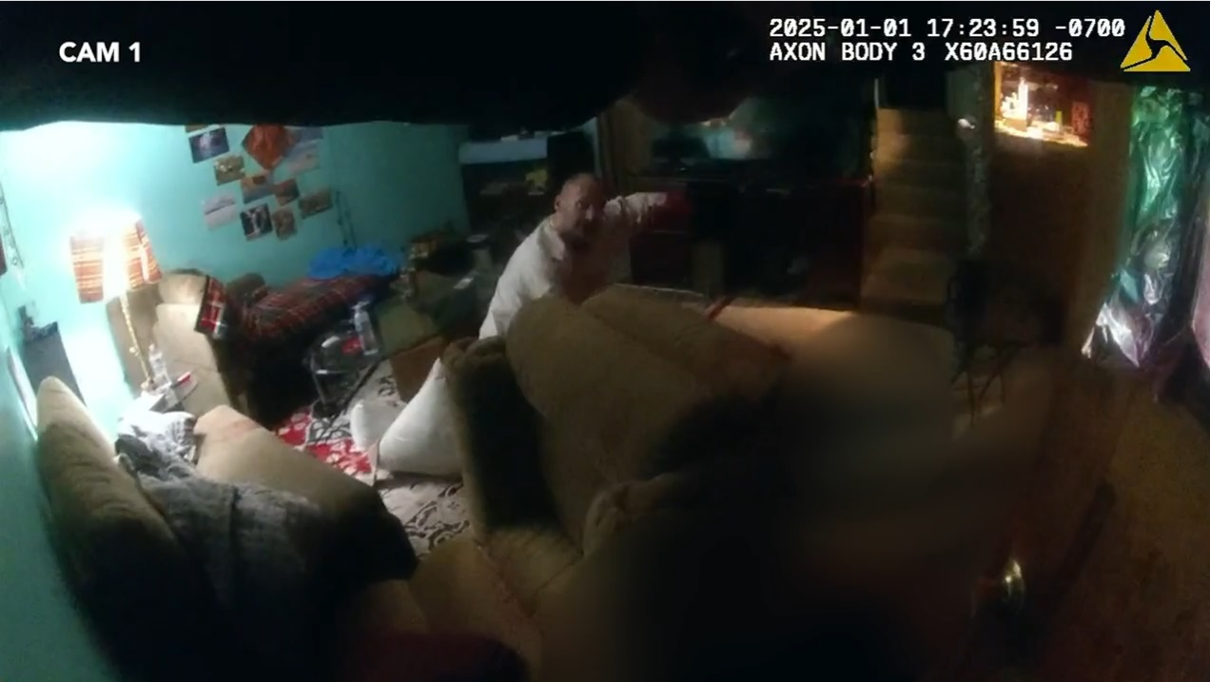
Man who stabbed parents to death
Protecting people from media exposure is hard
Take care of yourself

Slide 10
Do’s and Don’ts
Don’t do interviews just because you’re asked
Do make sure the benefit outweighs the risk
Don’t speculate
Do stick to the facts
Don’t wait to communicate
Do greet media
Don’t get stuck
Do have a “crutch”

Slide 11
Do’s and Don’ts
Don’t worry if you mess up
Do ask to restart your answer
Don’t give one reporter or media outlet info
Do give the same information to all
Don’t exclude media from public areas
Do get media as close as you can
Don’t be afraid to say you don’t know
Do give interviews even with little info

Slide 12
Do’s and Don’ts
Don’t hesitate to say what you’ve done right
Do share your successes
Don’t be negative
Do keep comments positive/neutral
Don’t include race unnecessarily
Do include race only as outstanding
suspect description

Slide 13
Do’s and Don’ts
Don’t let down your guard
Do be cautious of your behavior and comments

Slide 14

Questions?
Roxeanne Vainuku
rvainuku@gmail.com
801-503-7678

