Slide 1

Demystifying Insurance Provisions in Contracts and Certificates of Insurance

Slide 2

Objectives of This Training
Serve as a guide in developing proper insurance requirements in most contracts.
Hold Harmless Language and why it is important?
What is a Certificate of Insurance and Why Do We Need them?
Why is it important to have all three when working with vendors, contractors, leases, etc. (insured contract/insurance, hold-harmless language and certificate of insurance/additional insured endorsement.

Slide 3

Insurance Requirements In Contracts
Let’s Be Real!!!!
Very few of us like to deal with contracts.
Even less of you like to haggle about the terms of a contract.
Probably none of you like to request, obtain and verify insurance that is required in contracts. It takes time. It’s aggravating dealing with contractors and insurance brokers AND it feels like it doesn’t even make a difference!!!!!!
HOWEVER – when an incident or problem occurs having strong insurance provisions and obtaining all the required info (Certificates, Endorsements, adequate limits, etc.) makes it all worth while.

Slide 4
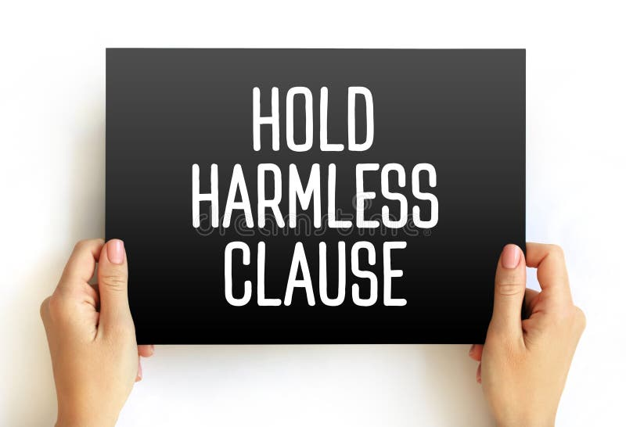
Why Do We Need Strong Indemnification Language and strong insurance requirements?
The City can be held liable for damages caused by contractors/vendors.
You should be able to rely on your contractor to do the job right and if they do not do the job right they should pay for the consequences.
You have a source for payment of claims against the City.
The City should attempt to transfer the risk loss where possible.
Keeps the City budget safe.
Keeps insurance/self insurance costs lower.

Slide 5

What Should Be Included the Insurance Section Contracts?
Review the Scope of Work and look at what could go wrong?
It is a total mistake to look at small jobs or small dollar contracts automatically think it carries a small risk of loss. Even the smallest job has a potential for a large exposure to the City.
For our discussion today, I am assuming the contract comes with standard risks for most contracted services, professional services, maintenance agreement's.

Slide 6
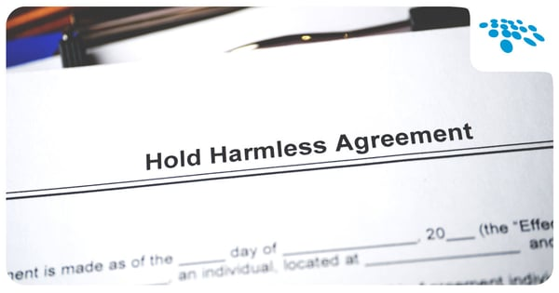
What Should Be Included in the Insurance Section of Contracts - Hold Harmless Language
All contracts should contain “Hold Harmless language.
Hold Harmless language is language that shifts responsibility for loss or damage in the City’s favor. It’s the Contractor’s promise to pay for claims caused, in whole or in part, from its activities.
The language should include an obligation to defend your entity (the City, employees, officials, agents, etc.) and is meant to be interpreted as broadly as possible in the City’s favor.

Slide 7
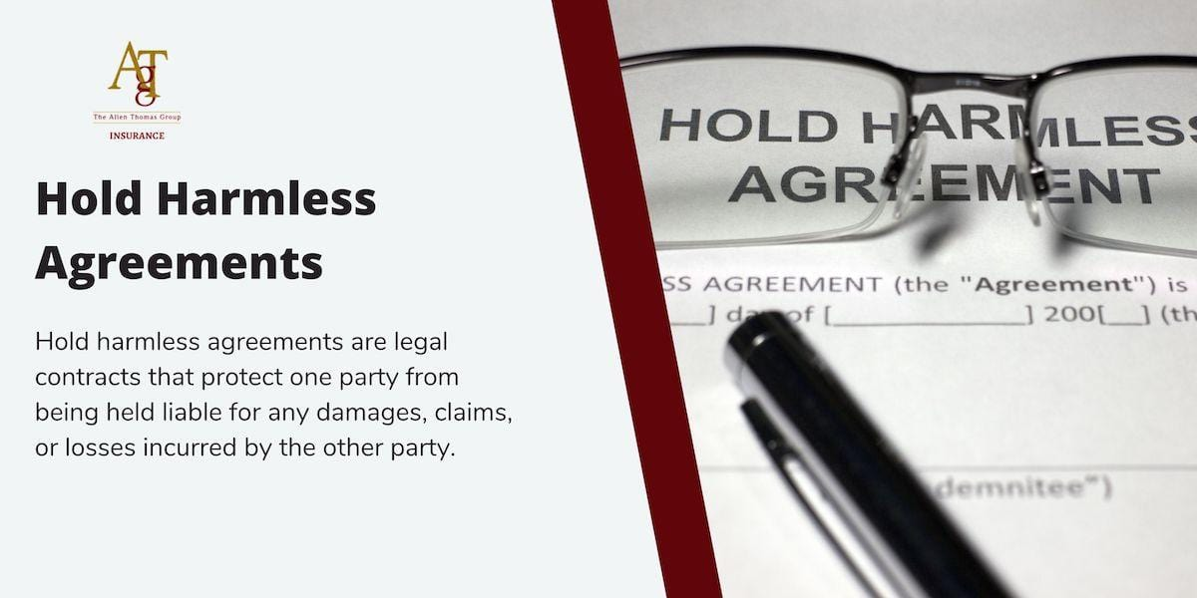
Hold Harmless Agreements
Hold harmless: to the fullest extent permitted by law, Contractor shall hold harmless, defend at its own expense, and indemnify the City its officers, employees, agents, and volunteers, against any and all liability, claims, losses, damages, or expenses, including reasonable attorney’s fees, arising from all acts or omissions of contractor or its officers, agents, or employees in rendering services under this contract; excluding, however, such liability, claims, losses, damages, or expenses arising from the City’s sole negligence or willful acts.
It is preferable that the City use their own contract form with language that has been drafted and/or reviewed by your attorney.
There may be times that you have to use the contractor’s contract. The problem with using the contractor’s contract is that some contractor’s work real hard trying to limit their obligations/exposure.
When you do have to accept the contractor’s contract or contract language, MAKE SURE it is reviewed by your attorney.

Slide 8

Insurance Requirements
Important to inform the contractor’s/vendors of the insurance requirements early (RFP or RFQ)
By informing them early
  1) you eliminate any questions regarding insurance;
  2) the contractor/vendor has the opportunity to send the forms/requirements to their broker for approval before the bid/quote is submitted;
  3) it eliminates in most cases any delays as it relates to insurance.

Slide 9
Sample Insurance Language
Insurance Requirements. Contractor agrees to have and maintain the policies set forth in Exhibit A entitled “INSURANCE REQUIREMENTS,” which is attached hereto and incorporated herein. All policies, endorsements, certificates, and/or binders shall be subject to approval by the City as to form and content. These requirements are subject to amendment or waiver only if so approved in writing by the City. A lapse in any required insurance coverage during this Agreement shall be a breach of this Agreement.

Slide 10
Sample Insurance Language – Exhibit A
Exhibit A:
Insurance Requirements
Contractor shall procure and maintain for the duration of the contract insurance against claims for injuries to persons or damages to property which may arise from or in connection with the performance of the work hereunder and the results of that work by the Contractor, his agents, representatives, employees or subcontractors.
MINIMUM SCOPE OF INSURANCE
Coverage shall be at least as broad as:
Commercial General Liability (CGL): Comprehensive General Liability Insurance on an “occurrence” basis, including products and completed operations, property damage, bodily injury and personal & advertising injury with limits no less than $2,000,000 per occurrence. If a general aggregate limit applies, either the general aggregate limit shall apply separately to this project/location or the general aggregate limit shall be $3,000,000.
Automobile Liability: Auto Liability insurance covering any auto, or if Contractor has no owned autos, covering hired, and non-owned autos, with limit no less than $1,000,000 per accident for bodily injury and property damage.
Workers’ Compensation: Workers’ Compensation insurance with statutory limits as required by the Workers’ Compensation Act of the State of Utah unless a waiver of coverage is allowed and acquired pursuant to Utah law and Employer’s Liability Insurance with limit of no less than $1,000,000 per accident for bodily injury or disease. This requirement does not apply to individuals not employed with a company or other commercial entity.
Professional Liability (Errors and Omissions): Insurance appropriate to the Contractor’s profession, with limits no less than $1,000,000 per occurrence or claim, $2,000,000 aggregate.
If the Contractor maintains broader coverage and/or higher limits than the minimums shown above, Draper City requires and shall be entitled to the broader coverage and/or the higher limits maintained by the contractor. Any available insurance proceeds in excess of the specified minimum limits of insurance and coverage shall be available to Draper City.

Slide 11
Limits of Insurance
URMA recommends that the minimum limit is $1,000,000 per occurrence, accident or claim for CGL, E&O and Professional Liability. Aggregate limit recommended by URMA is $4,000,000.
Obviously – limits should be increased for higher risk activities including construction contracts, fireworks, working with explosives, etc.

Slide 12
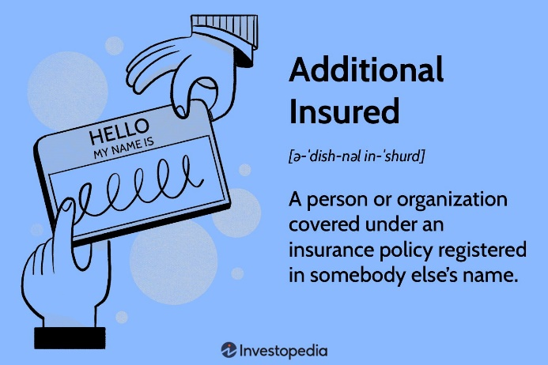
Other Appropriate Insurance Provisions
Additional Insured – the City should be named as an additional insured by ENDORSEMENT under the contractor’s/vendor’s policy arising for covered claims from their work or activities on your behalf.
This gives the City direct rights under the contractor’s/vendor’s insurance policy. This is not required for WC and is not available under Professional Liability.
Primary Coverage – for all required policies, you want to require the contractor/vendor to be the first to cover any claim, with your coverage applicable only if the Contractor’s insurance is exhausted.

Slide 13
Other Appropriate Insurance Provisions
Waiver of Subrogation – if an insurer pays a claim, any rights their insured may have to recover all or part of the payment from someone else are transferred to the insurer – that is subrogation.
Your insurance requirements should contain a waiver of subrogation – preventing the Contractor’s rights to recover such payments.
Notice of Cancellation – you want to be notified immediately if the policy is cancelled!!!! The contractor’s agent or broker is responsible to notify you.

Slide 14
Other Appropriate Insurance Provisions
Deductibles and Self-Insured Retentions – you need to be especially careful with Self-Insured Retentions or High Deductibles. The insurance carrier does not start paying until the SIR/Deductible is exhausted.
You want to make sure that any amounts a Contractor must pay before its insurance applies are known and that the contractor is capable of paying those amounts.
Verification of Coverage – you need proof of your contractors insurance coverage. That is provided by the agent/broker with a Certificate of Insurance.
Certificates of Insurance lists the type of coverage, insurers providing coverage, policy period and limits. The City should be listed as the Certificate Holder.
For ongoing contracts or contracts that go on for a period of time, you should get a new Certificate of Insurance when the policy expires, BUT many times you will have to request a new certificate.

Slide 15
Other Appropriate Insurance Provisions
Claims Made Policies - there will be a number of professions that you will require Professional Liability insurance which is almost always written on a claims made basis.
Claims made policy’s are the policy in force on the date a claim is made against the Contractor is the one that covers the loss. It doesn’t matter when the occurrence/accident took place. It only matters when the claim is officially made.
Professions such as architects, engineers, companies that deal with pollution and sometimes accountants.
As a result of the “Claims Made” policy - it is recommended that you require proof of ongoing coverage for at least 3 years and possibly up to 10 years (for design issues or structure issues).

Slide 16

Other Insurance Provisions – Acceptability of Insurers
At least a minimum A.M. Best rating of A: VII.
Sometimes the insurer is not A.M. Best Rated. Sometimes you will have to look at financials or request other documentation or research the internet because they are covered by a Captive, Self-Insured Group; Insurance Pool or other forms of alternative risk financing.
I will discuss AM Best ratings more when I talk about Certificates of Insurance.

Slide 17
Questions/Scenarios
Is it all right if the contractor alters the indemnification language?
This is not advised. Indemnification language is carefully worded to afford your City as much protection as legally possible, and usually the exact language has been tested in court. Altering the language could weaken your City’s protection and should only be undertaken on advice of your legal counsel.

Slide 18
Questions/Scenarios
If the agent or broker changes the word “endeavor” to “will provide” in the notification section of the certificate of insurance, are we okay?
No; Certificates of insurance DO NOT alter the insurance coverage, and any changes that are necessary need to be endorsed onto the policy with a copy of the endorsement provided to your Entity. Agents and brokers will sometimes try to convince you that endorsements are unnecessary when the certificate has its standard wording changed; if so, you need to point out the box in the upper right hand corner of the certificate, which states that it DOES NOT amend or alter the insurance.

Slide 19
Questions/Scenarios
What can be done if we don’t have the proof of insurance when it is time to start the work?
There is very little that can be done at this point in the process, which is why it is strongly recommend that the indemnity and insurance specifications be sent out with the pre-bid package. There are no good choices when this situation occurs; either you must delay the work while you wait for the proof, or you must take some risk until the proof is received, and hope that the contractor’s insurance meets your specifications.

Slide 20
Questions/Scenarios
The contractor’s agent says that we cannot get the endorsements as required by the Insurance Requirements in Contracts specifications; what can we do?
In many instances, the agent or broker has not approached the insurance company with your request – the agent or broker is merely trying to discourage you from asking so that it will not have to bother. We recommend contacting the broker or agent directly. By informing the agent or broker of the needs and requirements of your City, he or she will typically provide you with the necessary endorsements required by your City. If this tactic does not work, please call an insurance advisor for confirmation of the unavailability of endorsements from the contractor’s company.

Slide 21
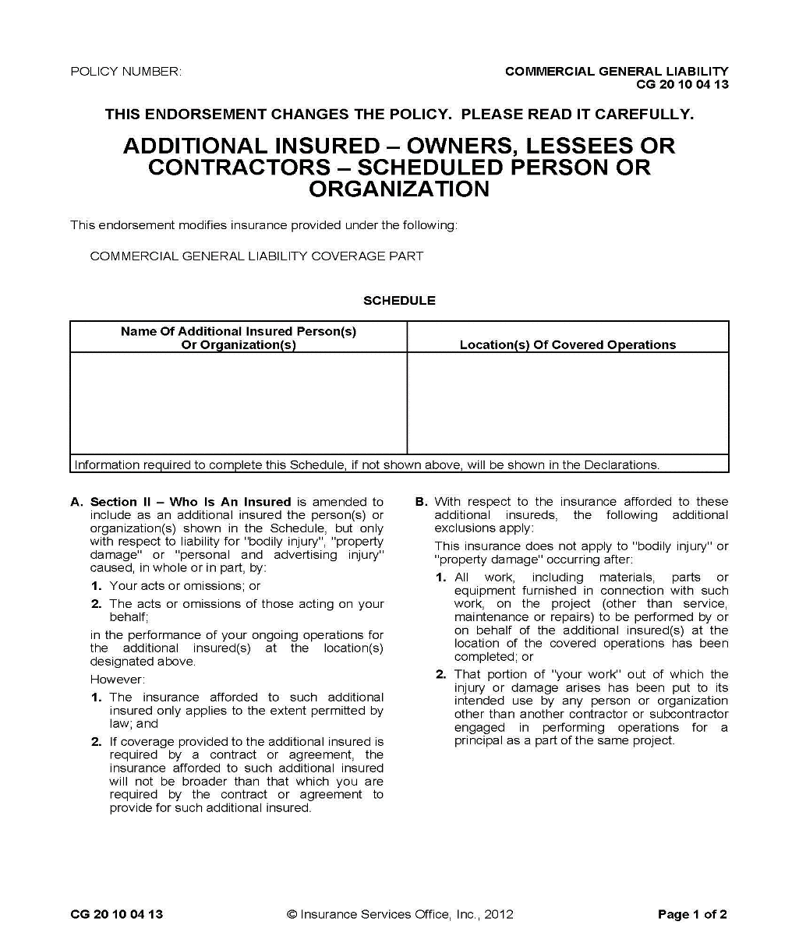
CERTIFICATES OF INSURANCE & ADDITIONAL INSURED ENDORSEMENTS

Slide 22
What Will Be Discussed?
Certificates of Insurance
  What Are Certificates of Insurance?
  Why Do We Need Them?
  Important Things to Look At
Additional Insured Endorsements
  What is an Additional Insured Endorsement?
  Why Do We Need Them?
Certificates of Insurance, Additional Insured and Hold Harmless
Some Questions/Scenarios

Slide 23
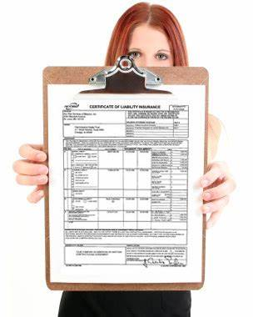
What is a Certificate of Insurance?
A Certificate of Insurance is a document that gives evidence of the insured’s financial ability (via an insurance policy) to respond to a claim.
No coverage benefits are afforded to the certificate holder; the Certificate merely confirms that the subject company carries insurance.

Slide 24
Certificates of Insurance
Why are Certificates needed?
  Certificates give evidence that the other party has appropriate insurance to cover the claims for which they are responsible.
When are Certificates needed?
  Certificates are needed when another party (janitorial service, security services, construction projects, etc.) performs services on your behalf or has property in care, custody, or control (leasing your facility).
Who should provide the Certificates?
  The other party’s insurance agent, broker, insurance pool or risk management department.

Slide 26
What to look for on Certificate of Insurance/Addt. Insured Endorsement?
Evidence provided for each type of insurance required in the contract (e.g., “Commercial General Liability”, Auto Liability, Workers Compensation, and Professional Liability or E&O, per the contract specifications). #3 on left
General Liability is on an “occurrence” basis, not “claims-made.” #6 on left
Auto Liability covers “any auto” (or non-owned & hired, if contractor has no autos). #3 on left
Limits are at least as high as the minimum required in the contract. #8 on right
Workers Compensation provides appropriate Limits & Employers’ Liability of $1 million. #3 on bottom left
Policies are current and will not expire during the contract period (you should have some sort of tickler system or use Moreton for renewal follow-up if the contract period runs beyond the policy expiration date). #7 – 2 columns
Excess liability policies have coverage periods concurrent with primary policies. #3 - Umbrella
Insured Name is the same as Contractor named in the contract. #4
The insurer’s A.M. Best and Standard & Poor’s ratings meet or exceed the Entity’s minimum requirements. Are we even checking these? #3 top right

Slide 27
What To Look For on Certificate of Insurance/Addt. Ins. Endorse.
Self-Insured Retention (SIR) on liability policies? Any must be disclosed & approved.
Descriptions of operations, locations, etc. are correct? Bottom
Certificate Holder (your City) is correct, with attention to correct person. The certificate holder should list the City not the Parks Department or Public Works, etc. #10
Certificate provides for 30-day notification (10 days for non-payment) to City of changes or cancellation.
Certificate includes signature of authorized representative. #12
Additional Insured Status - e.g., Form CG 20 10 11 85 or both CG 20 10, CG 20 26, CG 20 33, or CG 20 38; and CG 20 37 if forms with later edition dates provided
“Blanket” Endorsement.
Entity-Supplied Endorsement provided and signed.

Slide 28
Additional Insured Endorsements
What is an “additional insured”?
In insurance policies, an additional insured is a person or organization who enjoys the benefits of being insured under an insurance policy, in addition to whoever originally purchased the insurance policy. The term generally applies within liability insurance and property insurance but is an element of other policies as well. Most often it applies where the original named insured needs to provide insurance coverage to additional parties so that they enjoy protection from a new risk that arises out of the original named insured's conduct or operations. An additional insured often gains this status by means of an “endorsement” added to the policy which either identifies the additional party by name or by a general description contained in a "blanket additional insured endorsement".

Slide 29
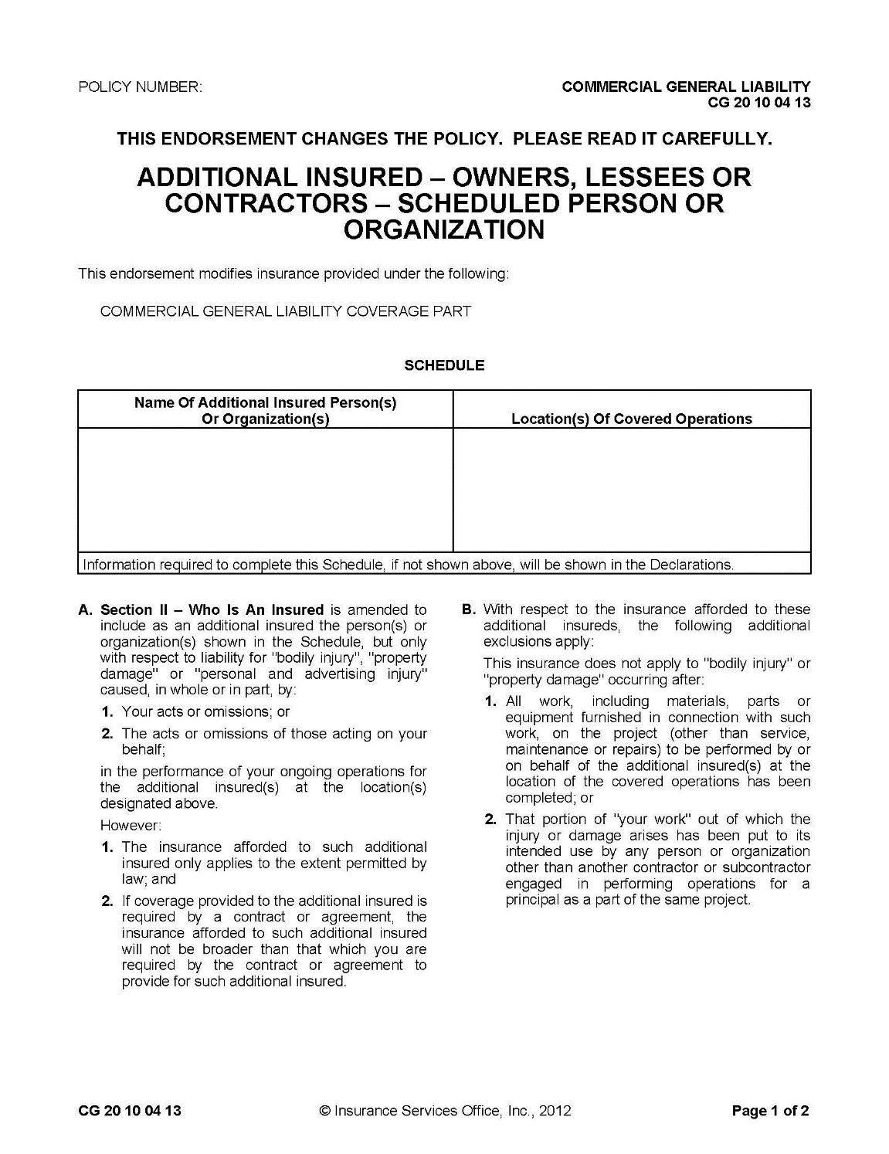

Slide 30
Additional Insured Endorsement
By requiring that your City be named as an additional insured under contractor’s or vendor’s insurance policy – it gives your City an extra layer of protection against claims by giving you DIRECT rights of coverage under that policy.
We should ALWAYS require being named as additional insured by ENDORSEMENT on the other party’s policy when:
  They are a contractor or vendor working on the City’s behalf.
  They are directing or controlling the work of any of our employees in a situation where injury might result.
  They are leasing space in a building or property we own.
  They are conducting a special event (wedding, parade, bounce house, fireworks, etc.) and utilizing our facilities or property.

Slide 31
Additional Insured Endorsement
Why can’t we accept a Certificate of Insurance as proof of the Entity being named as an additional insured?
In the upper right-hand corner of the ACORD Certificate of Insurance are the following words:
  This certificate is issued as a matter of information only and confers no rights upon the certificate holder. This certificate does not amend, extend or alter the coverage afforded by the policy below.
Right below that language is:
  IMPORTANT: If the certificate holder is an additional insured – the policy MUST BE ENDORSED.
If any agent or broker tries to convince you that the certificate truly does confer rights or coverages, and that you therefore do not need the endorsements you are requesting (and some will) you can direct their attention to these statements.

Slide 32
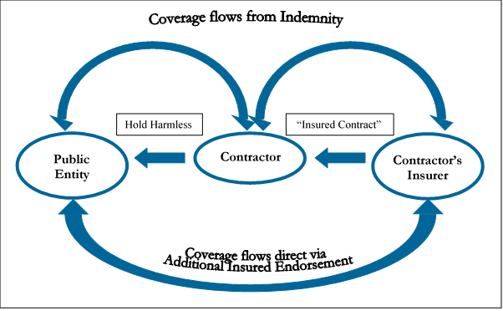
Certificates of Insurance

Slide 33
Scenarios/Questions
The contractor’s agent says that we cannot get the endorsements as required by the Insurance Requirements in Contracts Specifications; what can we do?
In many instances, the agent or broker has not approached the insurance company with your request – the agent or broker is merely trying to discourage you from asking so that it will not have to bother.
Do we need an additional insured endorsement on an automobile liability policy?
An additional insured endorsement is usually not required on most business auto policies because the standard ISO (Insurance Services Office) forms now include coverage for “anyone held liable for the conduct of an insured is also considered an insured”. Be careful with non-ISO policies since many, but not all, may contain this provision. It may be wise to require the additional insured coverage by using contract requirement language for the auto policy such as “the policy shall contain, or be endorsed to contain, Additional Insured coverage for the Entity.”

Slide 34
Scenarios/Questions
Can we accept an insurer with less than an A.M. Best Rating A: VII or Standard & Poor’s BBB?
Yes; but not recommended. Keep in mind that the rating gives your City some confidence in that insurer’s ability to cover all of its claim liabilities, including your potential claim. By accepting lower A.M. Best or Standard & Poor’s ratings, you are exposing your City to the possibility that the insurer will be unable to pay any claim you or a third party may present.
How do we discover what the rating of an insurer is?
A.M. Best ratings can be accessed over the internet for no cost at www.ambest.com.

Slide 35
Scenarios/Questions
Should we ask to be named as an additional insured on the contractor’s professional liability policy?
No; the contractor’s professional liability insurer will not comply with such a request. The reason is that the insurer does not want to pick up your City’s professional liability hazards, which it would do if you were an additional insured.

Slide 36

Questions?

