Slide 1
Premises Liability in Utah
Presented by: Heather White

Slide 2
Introduction
Definition of Premises Liability
  Legal responsibility of property owners/occupiers for injuries occurring on their property
Purpose of the Doctrine
  Promote safety and accountability
  Balance rights of property owners and visitors

Slide 3
Introduction
Standard of Care Based on Visitor Status
  Invitees
    In Utah, an invitee is someone who enters another person’s property with the express or implied invitation of the owner or occupier, typically for a purpose mutually beneficial to both parties—most often in a business or public context.
    Highest duty
      Inspect the premises for dangerous conditions
      Maintain the premises in a reasonably safe condition
      Warn invitees of hidden dangers the owner knew or should have known about
    Invitees are entitled to expect that landowners will exercise reasonable care to discover and correct unsafe conditions.
    Landowners can be liable for both known and reasonably discoverable hazards.
    Invitee protections may not apply if the individual deviates from the invited area or purpose.
    The Utah courts may consider foreseeability of harm and reasonableness of precautions when determining liability.

Slide 4
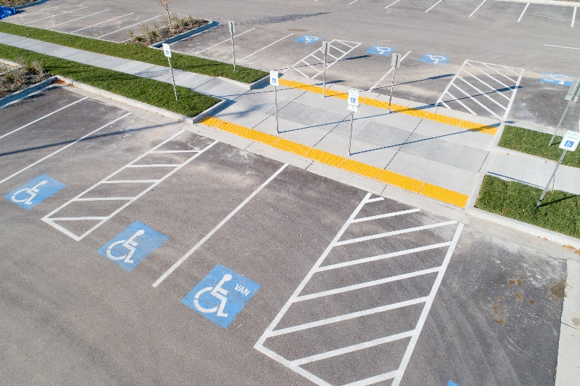
Common Types of Premises Liability Claims
Slip and fall/trip and fall accidents
  Sidewalks
  Facilities
  Parking lots
Road hazards
Unsafe building conditions
Inadequate maintenance
Negligent security (third-party criminal acts)
Dangerous conditions on public or recreational lands

Slide 5
Elements of a Premises Liability Claim
Duty – Existence of legal duty to plaintiff
Breach – Failure to maintain safe conditions or warn
Causation – Direct link between breach and injury
Damages – Compensable harm

Slide 6
Key Defenses
Governmental Immunity (UCA § 63G-7)
  Special protections and exceptions for public entities
Lack of notice (actual or constructive)
No dangerous condition existed
Comparative Fault
  Plaintiff's own negligence reduces or bars recovery
Open and Obvious Doctrine
  No duty to warn of dangers that are readily apparent
Assumption of the risk
Recreational Use Statute (UCA § 57-14)
  Limits liability of landowners who open land for public recreational use

Slide 7

Special Considerations
Children and Attractive Nuisance Doctrine
  Increased duty if a dangerous condition likely to attract children exists
Snow and Ice Accumulation
  Reasonable time to address after storm events (case-by-case)

Slide 8

Practical Risk Management Tips
Regular inspections and maintenance
  Industry standards on inspections and maintenance
  City policies on inspections and maintenance
  Training employees on inspecting, receiving reports (internal and external) and getting to the right people
Timely maintenance
  Reasonable time to fix
  Training employees on
  schedule for fixing

Slide 9
Practical Risk Management Tips
Incident documentation
  Success or failure largely dependent on record keeping
  Records for and action taken on complaints, inspections, and maintenance
    For this area
    For the type of area generally
    Timing
    What done
    Photos
  Complaints made to the City about this area prior to the accident
  An accident history for the area
  Information related to work done by others on the area

Slide 10
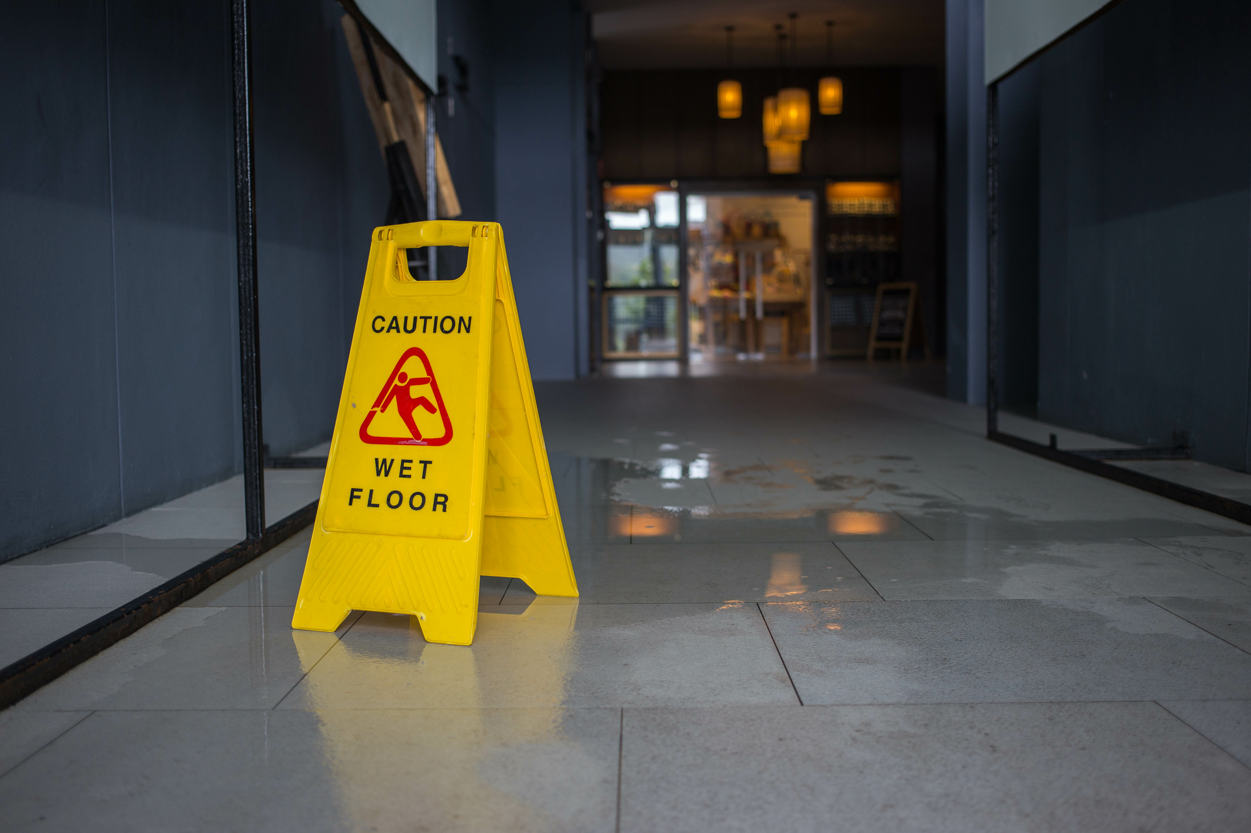
Practical Risk Management Tips
Clear signage for hazards
  Photos
Adequate lighting and security
Liability insurance coverage
  Don’t forget to require third-parties to include the City as an additional insured on their policies
Documentation on the City’s yearly budget for inspections and maintenance
  For possible discretionary function defense

Slide 11
Heather White
385.440.7079
hwhite@jshfirm.com

