Slide 1

Lessons Learned from Litigation

Slide 2


Lesson 1: An Ounce of Prevention is Worth a Pound of Cure
Risk Management 101
  Moroni Feed(“invoiced plant sales price”)
Good contracts make good neighbors
  Templates; review and update regularly
  Scooter company contracts
  Rawson

Slide 3

Lesson 2: Kindness and Respect Pay Dividends
Reduces likelihood of pursuing a claim
  For malpractice, the #1 factor is how the doctor treats people
Reduce costs in litigation
Increase chances of win-win settlement
Bird(technology)
Cosnyka

Slide 4
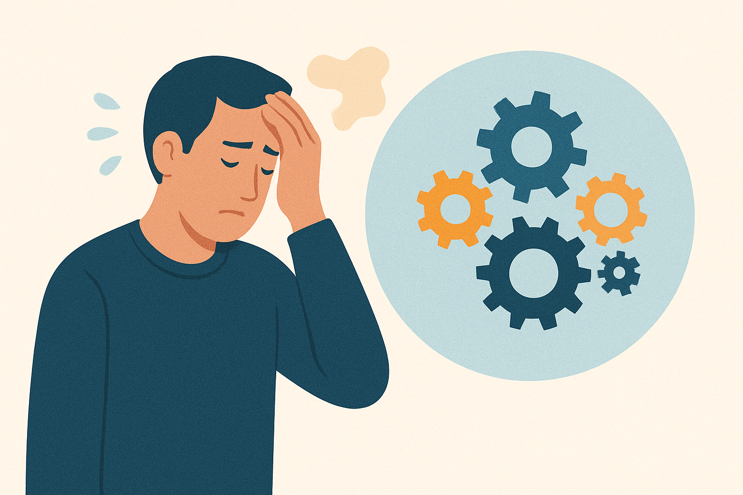
Lesson 3: Don’t Sweat the Small Stuff
All parties make mistakes before and during litigation
Patterson Construction v. Alpine City
Losing Procedural Objections
  SLC Hearings

Slide 5
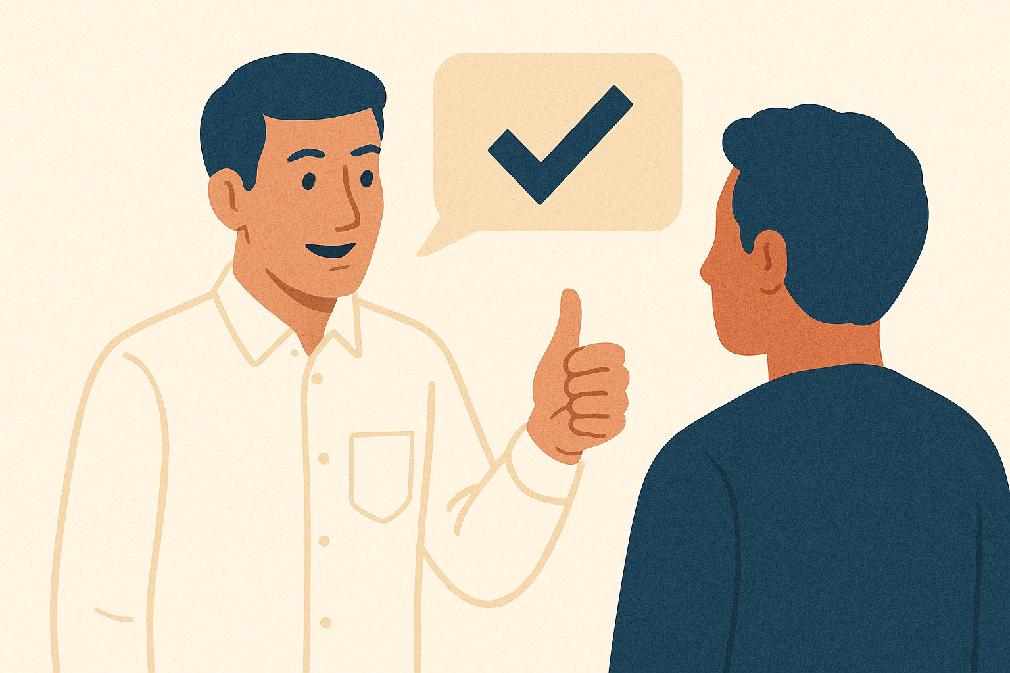
Lesson 4: When You’re Right, Stay Humble
You never know when you will discover something that turns your case upside down
  Litigation can be a roller coaster, with shifting probabilities
Your demeanor can affect whether the other side will recognize the flaws in its case
  We dig in our heels when people are confrontational about our mistakes
Hamilton

Slide 6

Lesson 5: There are ALWAYS More Sides to the Story
Discovery leads to “discovery”
Slam dunk cases are rarely that simple
Persistent (“allow customers to install without a license”)
Don’t reject reasonable settlement proposals out of hand just because you feel you have the upper hand

Slide 7
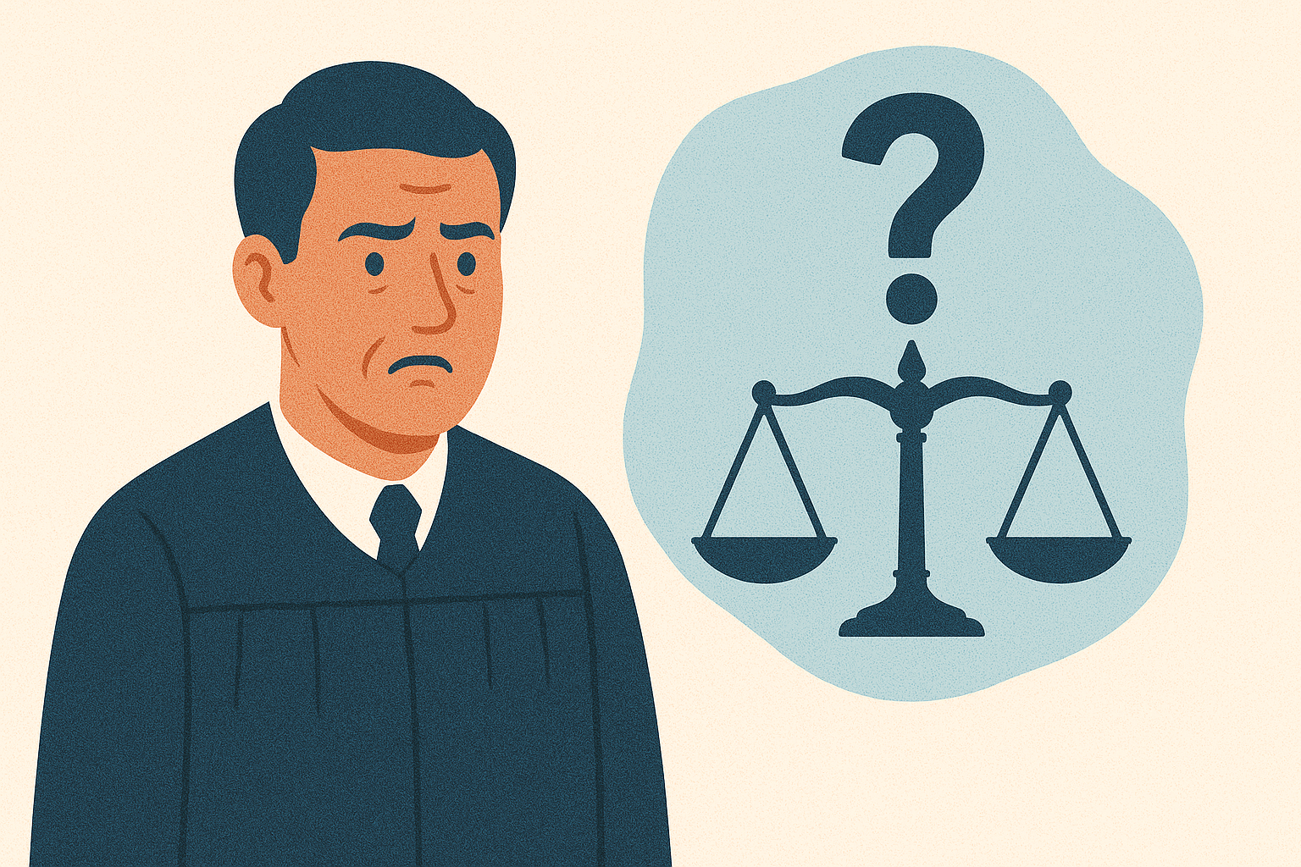
Lesson 6: Litigation is Unpredictable
This does not mean to avoid the fight; just be aware that you may unexpectedly win or lose
  Teng
  Bird jury polling
Sometimes, just playing the long game can work in a city’s favor
  This is especially true with cases where the plaintiff is less reliable
  Madrigal

Slide 8
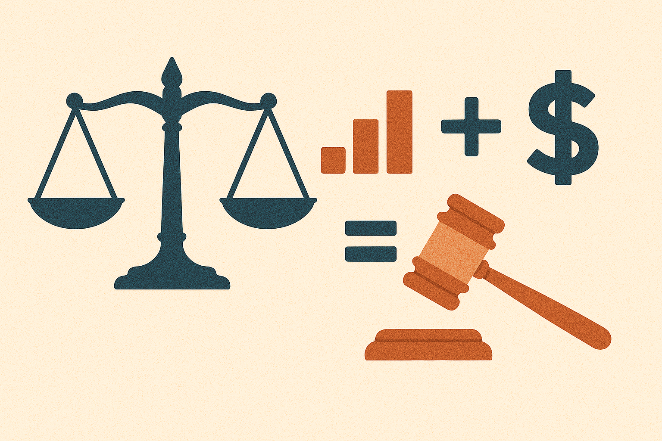
Lesson 7: Unless Attorneys Fees Are Available, the Mathematics of Litigation Work Against Everyone
This works against municipalities
But it works most against attorneys taking a contingency fee case
Madrigal ($7,000 case)
Plaintiffs’ attorneys often push desperately for settlement if you fight

Slide 9

Lesson 8: Don’t Do the Other Party’s Work for Them
We can be helpful without educating the public how to sue us
Pursuing a valid claim against an entity is hard; can be a helpful deterrent to litigation and lead to more reasonable settlements
During depositions, provide truthful answers, but don’t connect the dots for them
Hayes

Slide 10
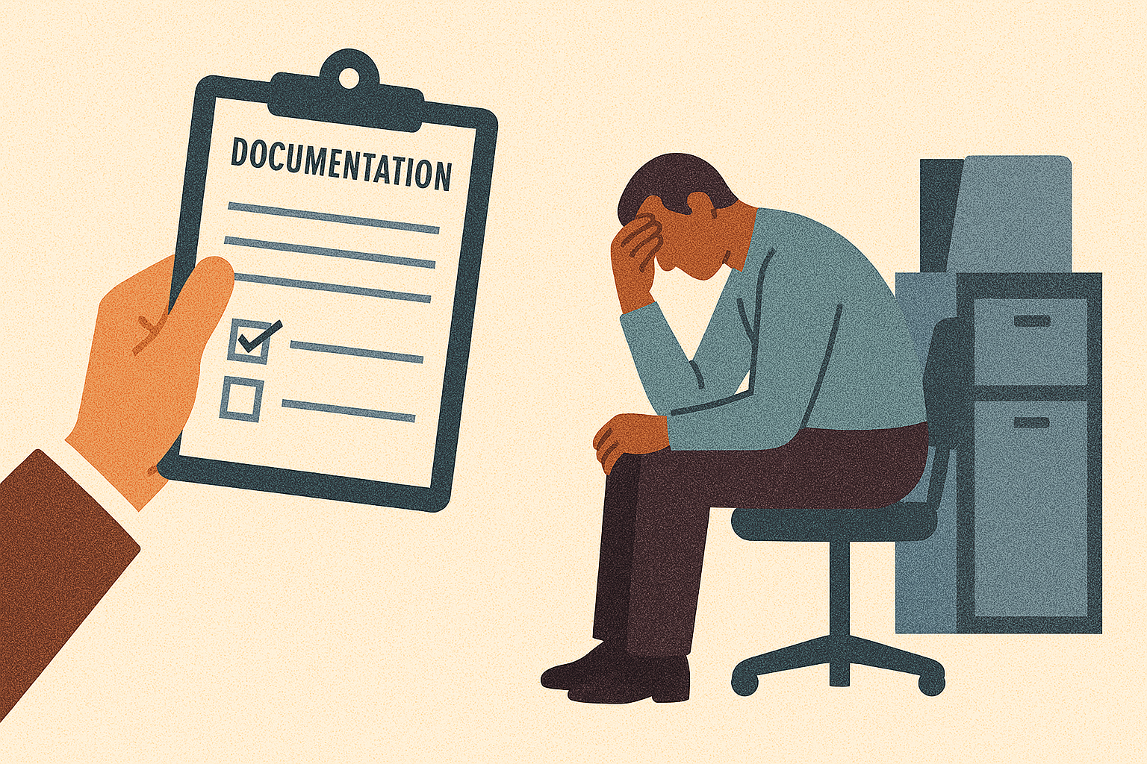
Lesson 9: Document and Deal with Employee Issues
Bad documentation can often be overcome, but it takes more effort and introduces unnecessary uncertainty
If you know of a problematic department or supervisor, don’t wait for someone to retire or the issue to work itself out
People are more likely to fight discipline when they genuinely feel it is coming out of nowhere
  Bird
  Holmes

Slide 11
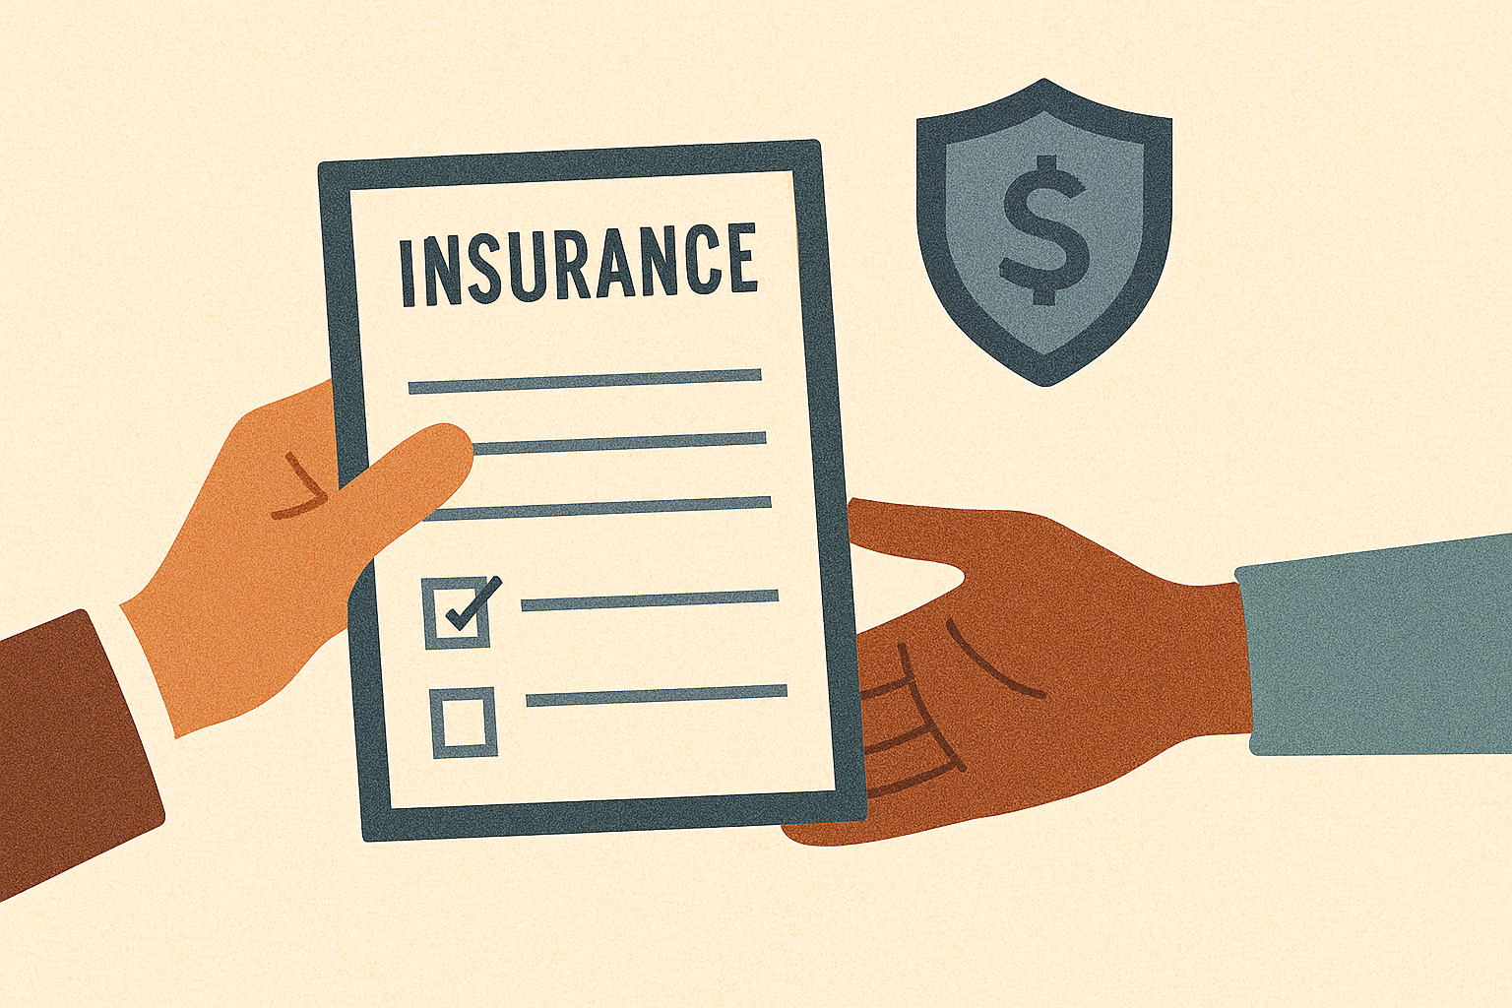
Lesson 10: Transfer Risk Consistently and Thoroughly
Contractor and Vendor Agreements
Indemnification and Additional Insured Provisions
Interlocal Agreements
  Caravan Logistics

Slide 12
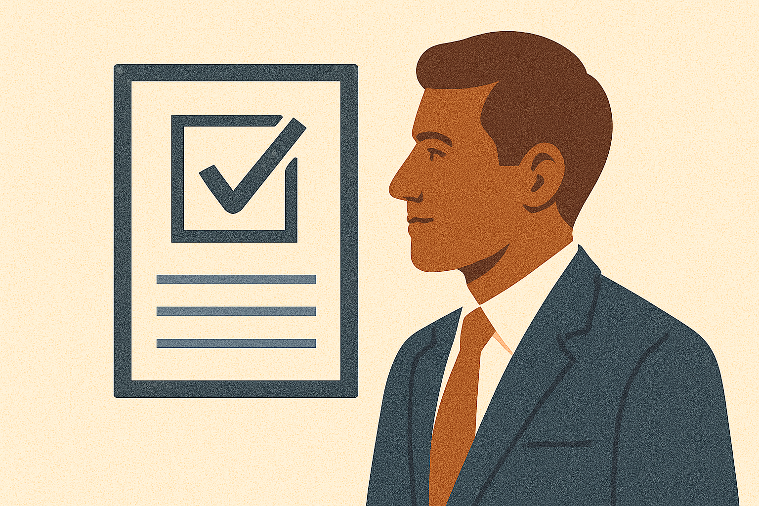
Lesson 11: Experience Matters
Provides Efficiency
Reduces Costs
  Hourly rate is not the only determinant of costs
Tunex bankruptcy

Slide 13
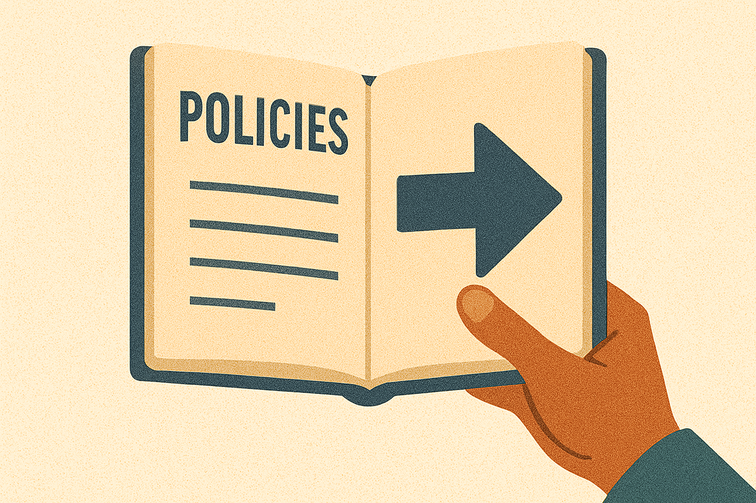
Lesson 12: Follow Your Policies!
Policies protect YOU
Failure to follow policies can be evidence of negligence
CNC
Whitney and MB

Slide 14
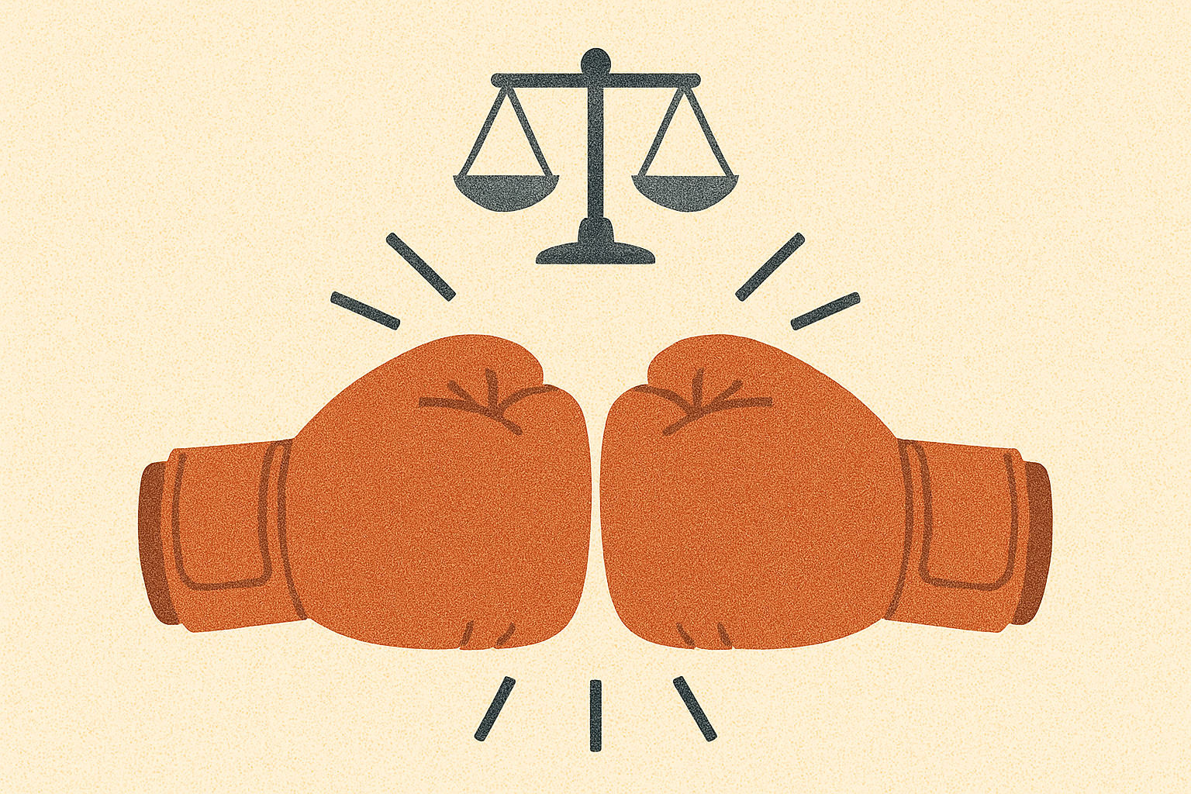
Lesson 13: If You’re Going to Fight, Do It Right
Minimizing costs is a noble goal, but it has its price
  Efficient and thorough work wins
Persistent
Bird (Facebook post)

Slide 15

Questions?
Brandon T. Crowther 801-531-5996 brandon.crowther@urma.gov

